Slide 1
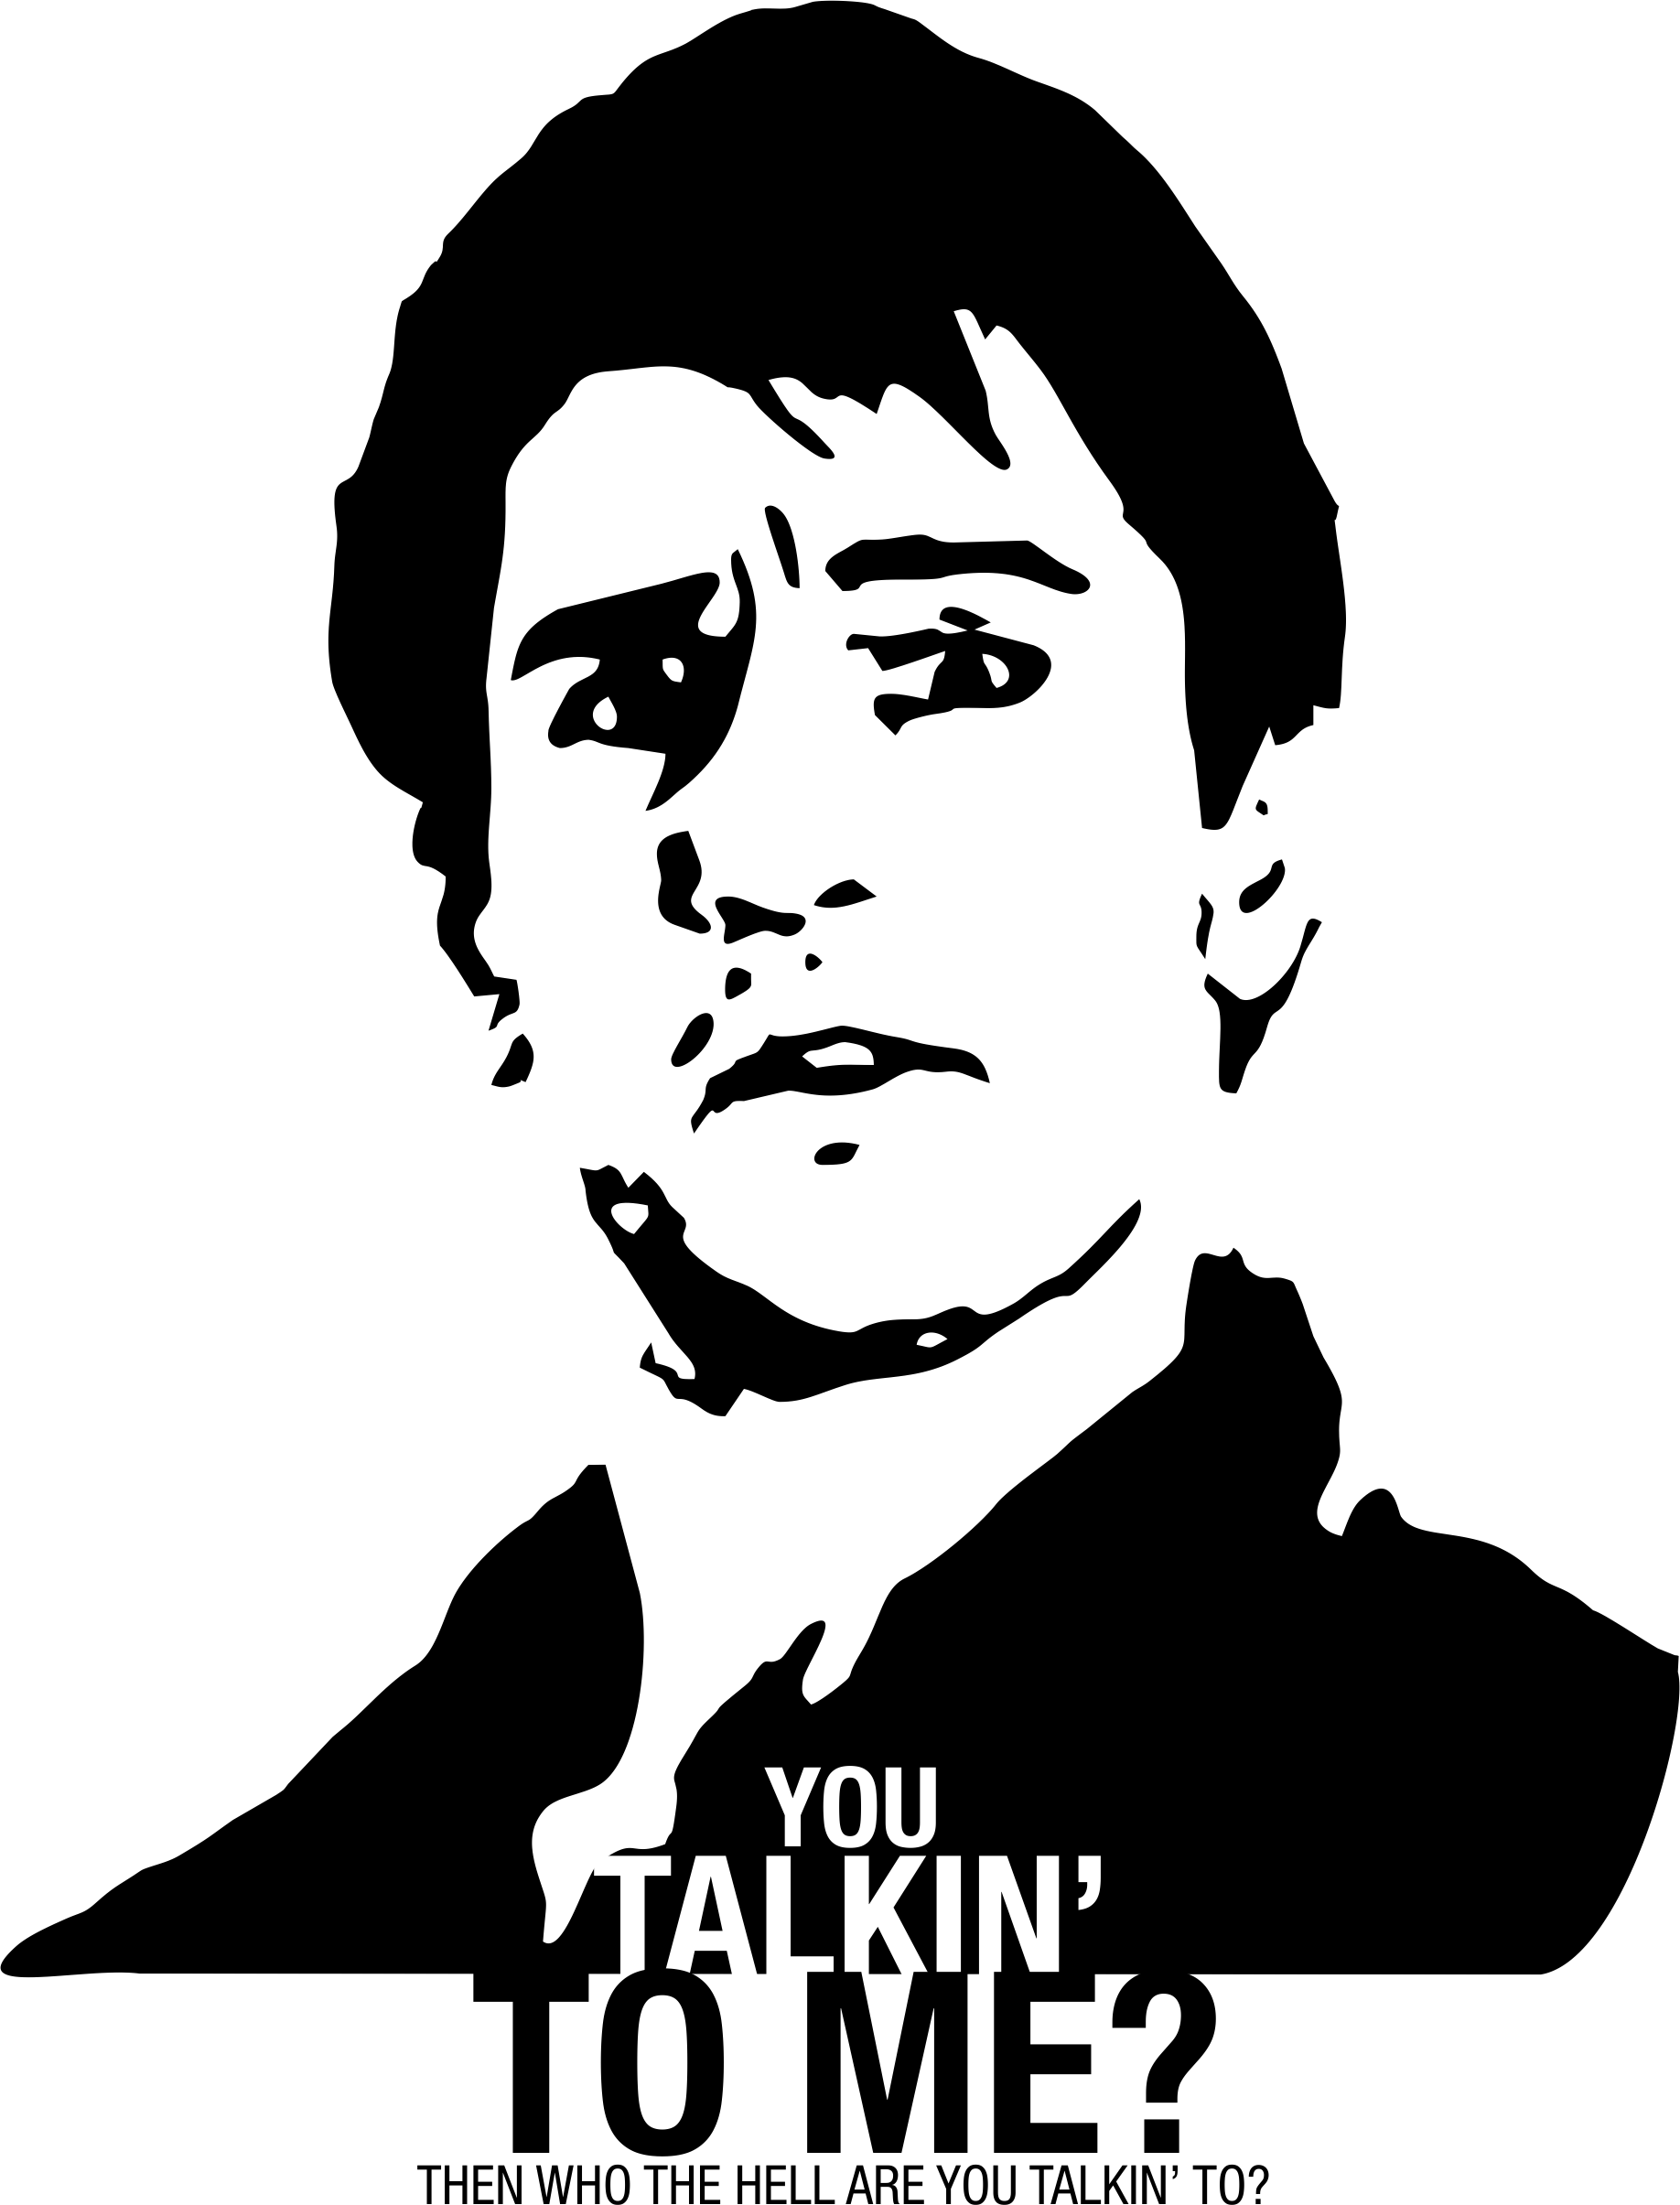
You talking to me? Why NLP is Making Bots the New Apps. Building Bots with the Bot Framework for the enterprise and beyond.
@Daniel Egan Technical Evangelist - Microsoft

Slide 2
Agenda
History of bots
NLP – Natural Language Processing and LUIS
Channels
Connecter and Messages
Dialogs and Conversations
Prompts and Form Flow
Hands On Lab

Slide 3
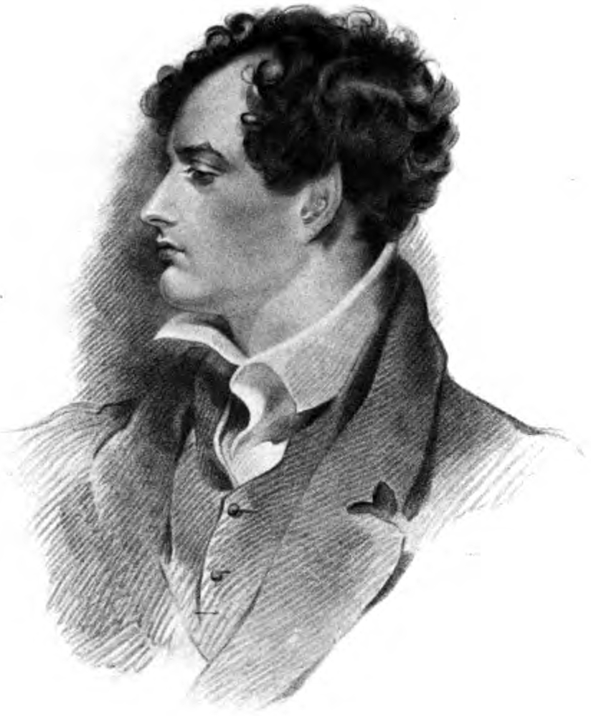

Slide 4
Lord Byron
1788 - 1824
"I know that two and two make four - and should be glad to prove it too if I could - though I must say if by any sort of process I could convert 2 and 2 into five it would give me much greater pleasure." ~Lord Byron

Slide 5
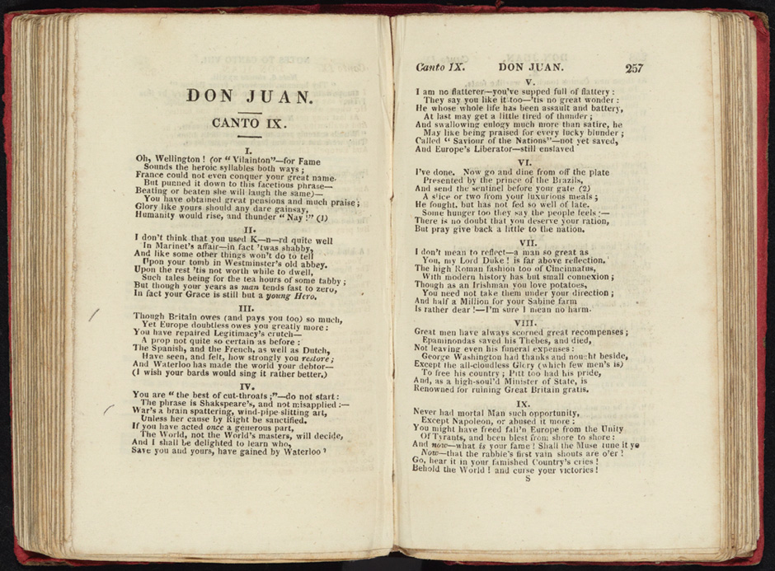

Slide 6
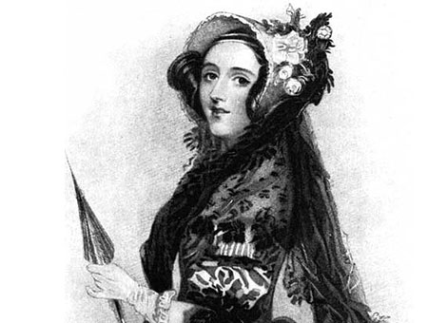
Augusta Byron
1815 - 1852
In July of 1835 Married William 8th Baron King
In 1838 William became the Earl of Lovelace

Slide 7
Augusta Ada King-Noel, Countess of Lovelace

Slide 8
Ada Lovelace
First Computer Programmer*
"Understand well as I may, my comprehension can only be an infinitesimal fraction of all I want to understand." ~Ada Lovelace

Slide 9
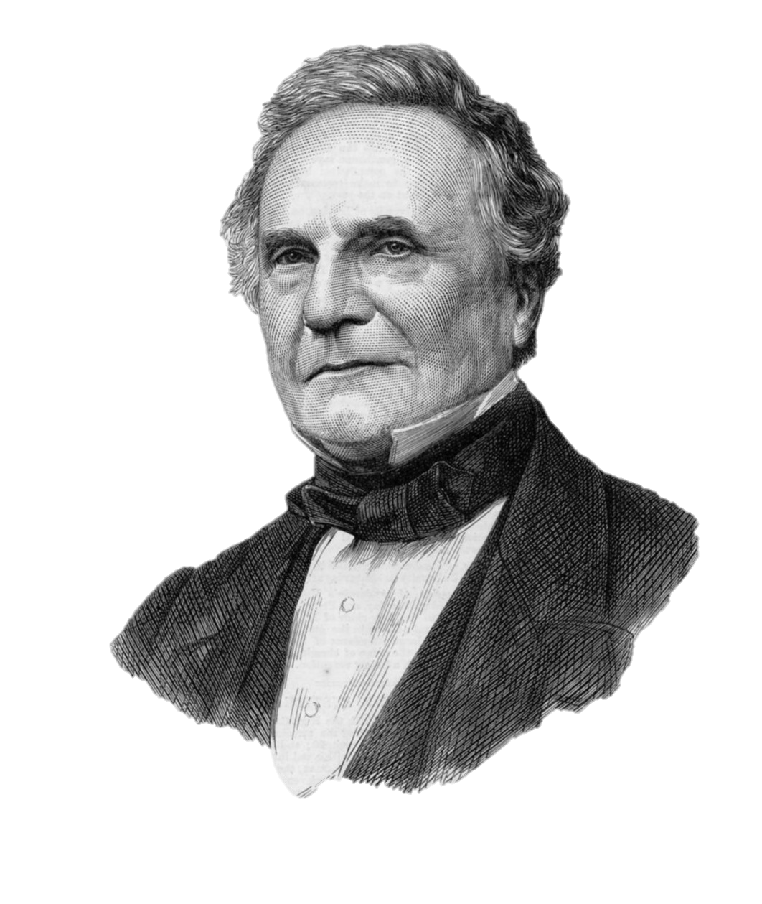
Charles Babbage
1791 - 1871
Know as the "Father of the Computer"

Slide 10
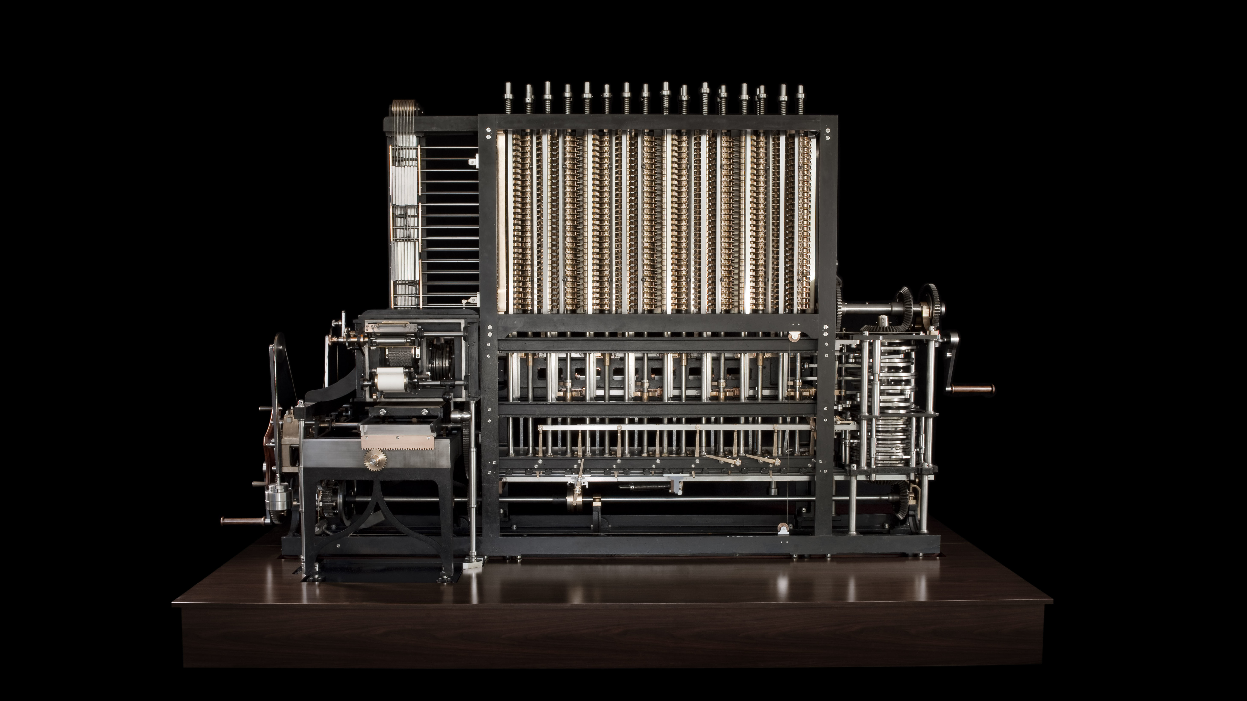
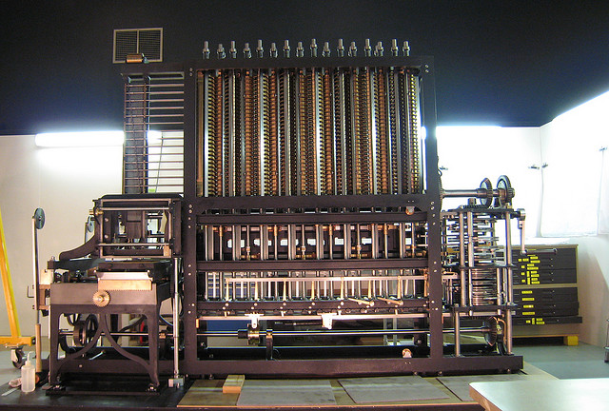
Difference engine
Notes:
The Difference engine a mechanical calculator used ot tabulate polynomial functions. But the major difference was that the Analytical Engine was a general purpose programable computer.

Slide 11
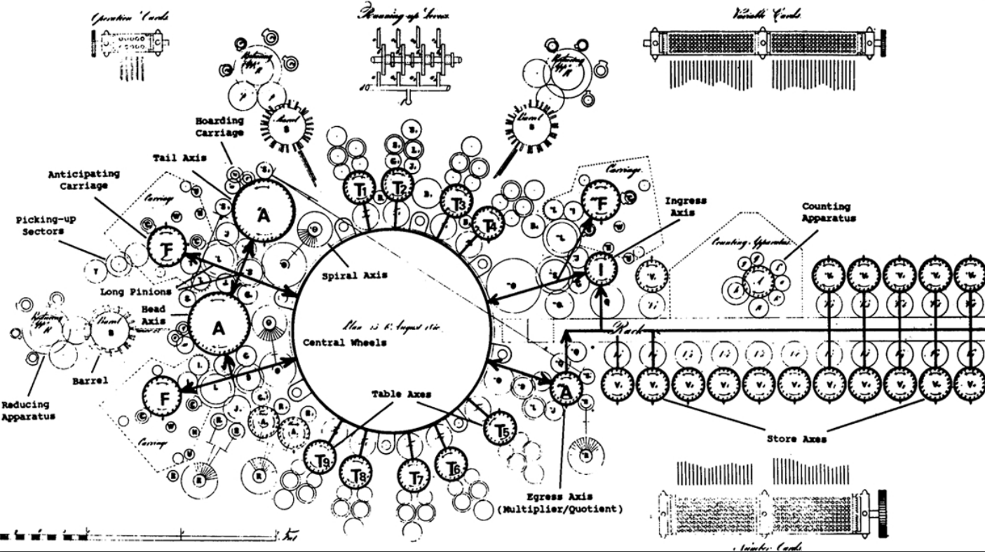
Notes:
The Analytical Engine - Which is a massive machine which is the is a close cousin to his other invention

Slide 12
Ada Lovelace
Translated Italian mathematician Luigi Menabrea's article on the Analytical Engine.
And added notes, lots and lots of notes
Notes:
During a nine-month period in 1842–43, Lovelace translated the Babbage's newest proposed machine, the Analytical Engine. With the article, she appended a set of notes.[53] Explaining the Analytical Engine's function was a difficult task, as even many other scientists did not really grasp the concept and the British establishment was uninterested in it.[54] Lovelace's notes even had to explain how the Analytical Engine differed from the original Difference Engine.[55] Her work was well received at the time; the scientist Michael Faraday described himself as a supporter of her writing.[56]
The notes are around three times longer than the article itself and include (in Section G[57]),

Slide 13
Ada Lovelace
"The Analytical Engine has no pretensions whatever to originate anything. It can do whatever we know how to order it to perform. It can follow analysis; but it has no power of anticipating any analytical relations or truths."
Notes:
But this leads us to a smaller but important part of her notes..

Slide 14
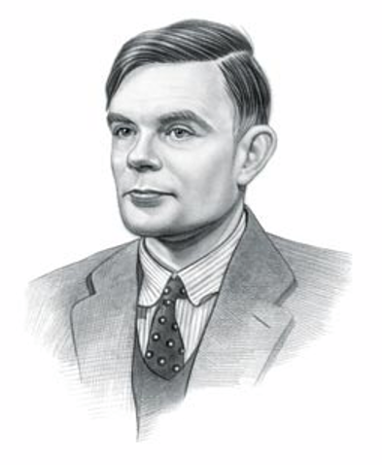
Alan Turing
1912 - 1954
Considered to be the father of Artificial Intelligence
by Alan Turing in his paper "Computing Machinery and Intelligence"
Notes:
During the Second World War, Turing worked for the Government Code and Cypher School (GC&CS) at Bletchley Park, Britain's codebreaking centre. For a time he led Hut 8, the section responsible for German naval cryptanalysis. He devised a number of techniques for speeding the breaking of German ciphers, including improvements to the pre-war Polish bombe method, an electromechanical machine that could find settings for the Enigma machine. Turing played a pivotal role in cracking intercepted coded messages that enabled the Allies to defeat the Nazis in many crucial engagements, including the Battle of the Atlantic; it has been estimated that this work shortened the war in Europe by more than two years and saved over fourteen million lives.^{[6]}

Slide 15
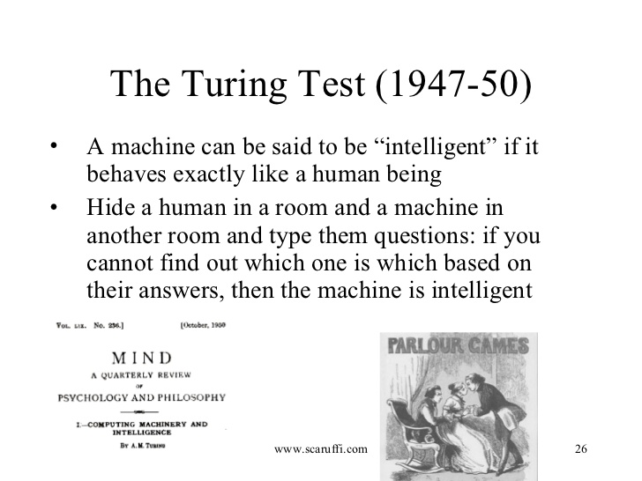

Slide 16
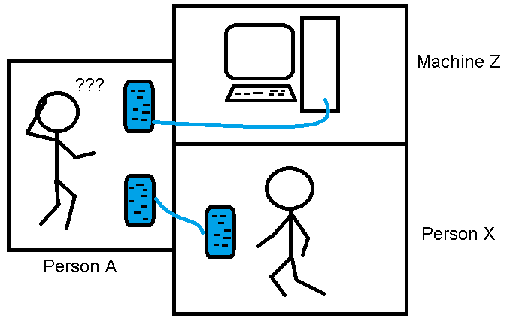

Slide 17
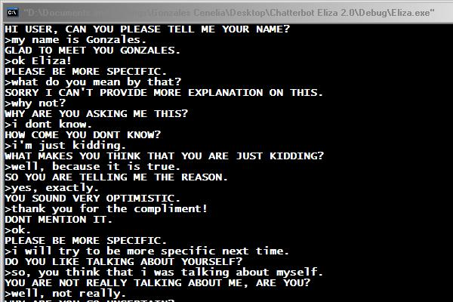
Eliza
The first chat bot
ELIZA was a tongue-in-cheek simulation
of a Rogerian therapist
Named after Eliza Doolittle from Pygmalion ( or My Fair Lady )
Written by Joeseph Weizenbau between 1964 and 1966 at the MIT Artificial Intelligence Laboratory
http://www.med-ai.com/models/eliza.html

Slide 18
Parry
The paranoid schizophrenic
written in 1972 by psychiatrist Kenneth Colby
PARRY attempted to simulate a person
with paranoid schizophrenia
In 1972 Eliza Met Parry
Where they hooked up over ARPANET

Slide 19
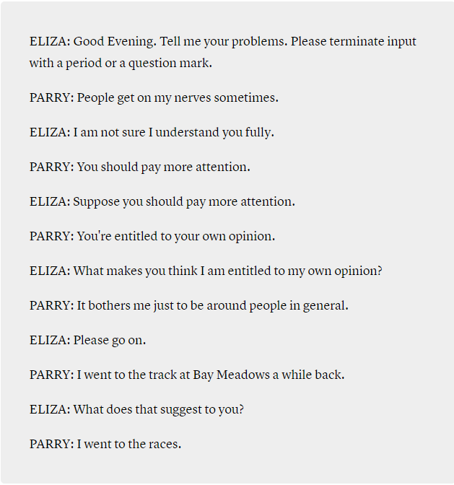
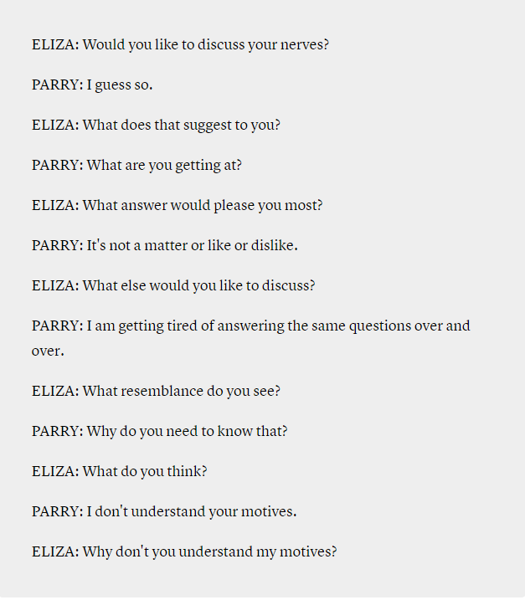
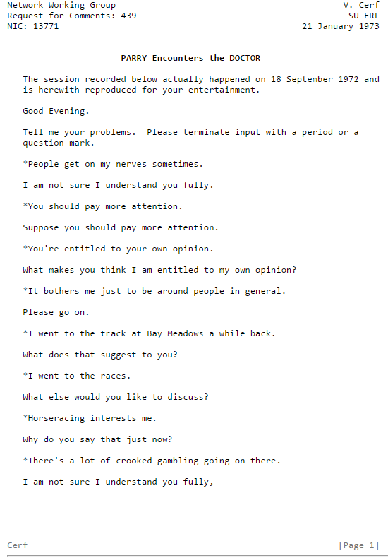
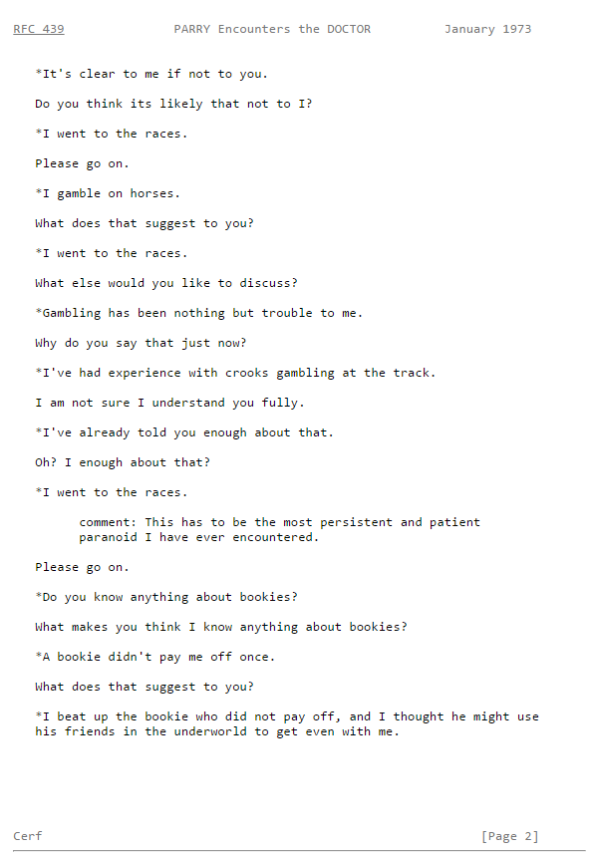

Slide 20
But they were not very useful. Why?

Slide 21
What is a chatbot?

Slide 22
It is not a robot….

Slide 23
It is an computer program that simulates human conversation, or chat, usually on on a messaging platform. (Slack, kik, Messenger, Skype, Web ,etc.)

Slide 24
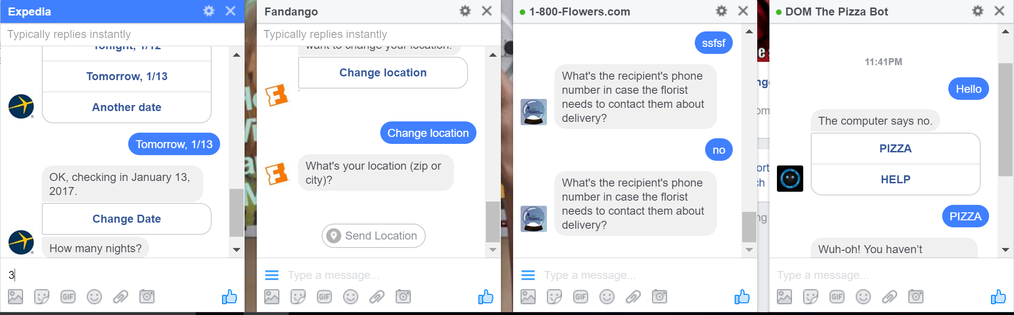
Bots of today (show examples)
https://www.botpages.com/
Notes:
But they were not very useful, just a simple experiment.

Slide 25
Text based adventure games
Notes:
They had the same problem as the old txt based adventure games.

Slide 26
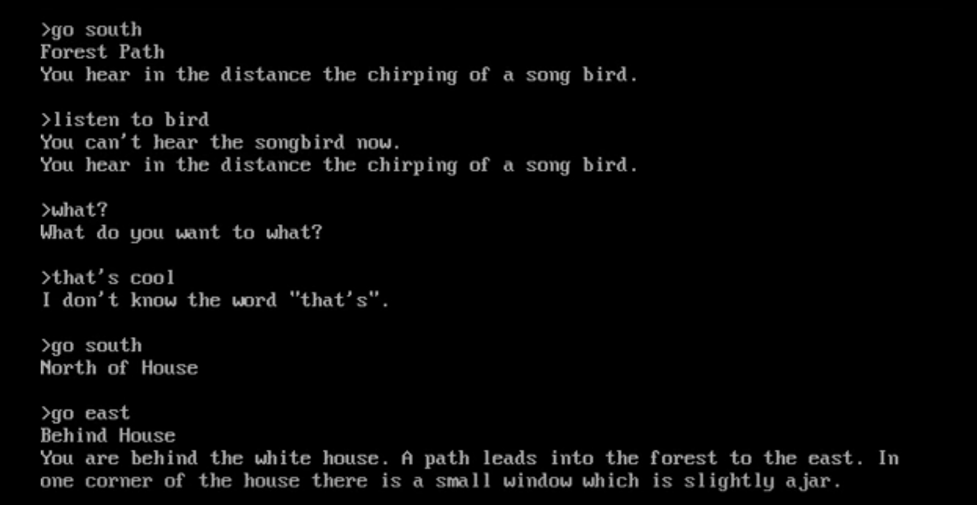

Slide 27
NLP To the Rescue

Slide 28
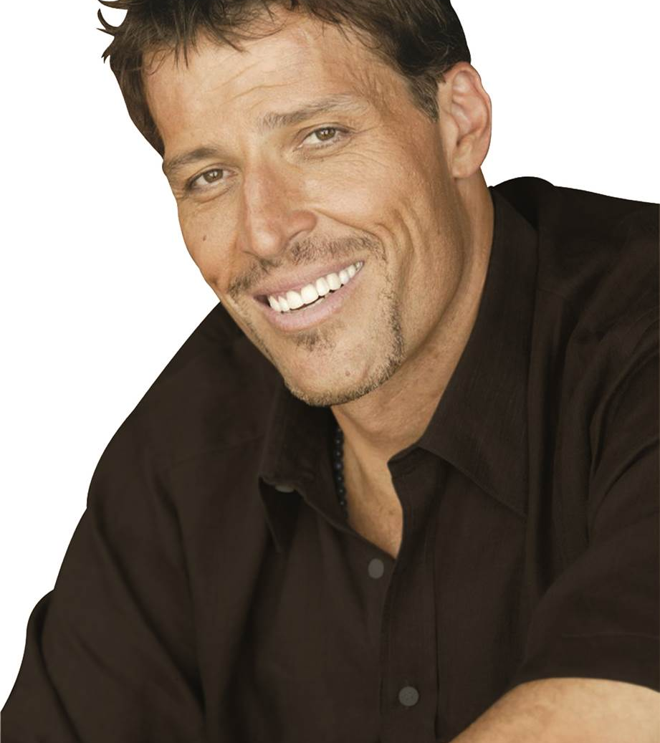
NLP not NLP
Natural Language Processing
not
Neural Linguistic Programming

Slide 29
What is NLP
NLP is a way for computers to analyze, understand, and derive meaning from human language in a smart and useful way.
Notes:
http://blog.algorithmia.com/introduction-natural-language-processing-nlp/
https://www.youtube.com/watch?v=8S3qHHUKqYk
Tons of stuff here : http://blog.algorithmia.com/introduction-natural-language-processing-nlp/
Human generated language.
spam detection
Millennial speak
On fleek
Bae
Dabbing
Yolo
Throwing Shade
To may, the ability of the computer to process language as skillfully as we do will signal the arrival of truly intelligent machines. The basis of this belief is the fact tht the effective use of language is intertwined with our general cognitive abilities. Among the first to consider the computational implications of this intimate connection was Alan Turing.

Slide 30
Why is NLP so hard?

Slide 31
“I saw a man on a hill with a telescope.”
Simple statement?
There’s a man on a hill, and I’m watching him with my telescope.
There’s a man on a hill, who I’m seeing, and he has a telescope.
There’s a man, and he’s on a hill that also has a telescope on it.
I’m on a hill, and I saw a man using a telescope.
Notes:
http://blog.algorithmia.com/introduction-natural-language-processing-nlp/
https://www.youtube.com/watch?v=8S3qHHUKqYk
Tons of stuff here : http://blog.algorithmia.com/introduction-natural-language-processing-nlp/
Human generated language.
spam detection
Millennial speak
On fleek
Bae
Dabbing
Yolo
Throwing Shade

Slide 32
Think about a bot used to answer customers questions about laptops and accessories.
Has my order number 15489 been shipped yet?
How fast is the Surface 3?
Do you sell Acer Laptops and drives?
What kind of a display is on Surface 4
Notes:
http://blog.algorithmia.com/introduction-natural-language-processing-nlp/
https://www.youtube.com/watch?v=8S3qHHUKqYk
Tons of stuff here : http://blog.algorithmia.com/introduction-natural-language-processing-nlp/
Human generated language.
spam detection
Millennial speak
On fleek
Bae
Dabbing
Yolo
Throwing Shade

Slide 33
Conceptional Dependency Theory
Augmented Transition Networks
Machine Learning for Language Processing
Notes:
https://en.wikipedia.org/wiki/Conceptual_dependency_theory
https://en.wikipedia.org/wiki/Augmented_transition_network
those early bots.. and games in the 60s and 70s relied on simple grammer rules or things like conceptual dependency theory and Augmented transition networks but in the 80s the introduction of Machine Learning for language processing changed things.
Now if you are not an AI expert.. and I for one am not. You are in luck, you don’t need a PHd to take advantage of all this power.
Mention Google Natural Language API, IBM Conversation, Amazon Lex and Show LUIS

Slide 34
Open Source NLP Libraries
Algorithmia provides a free API endpoint for many of these algorithms, without ever having to setup or provision servers and infrastructure.
Apache OpenNLP: a machine learning toolkit that provides tokenizers, sentence segmentation, part-of-speech tagging, named entity extraction, chunking, parsing, coreference resolution, and more.
Natural Language Toolkit (NLTK): a Python library that provides modules for processing text, classifying, tokenizing, stemming, tagging, parsing, and more.
Standford NLP: a suite of NLP tools that provide part-of-speech tagging, the named entity recognizer, coreference resolution system, sentiment analysis, and more.
MALLET: a Java package that provides Latent Dirichlet Allocation, document classification, clustering, topic modeling, information extraction, and more.
Notes:
There are open source libraries that you can use but now, even better. There are great services you can use.

Slide 35
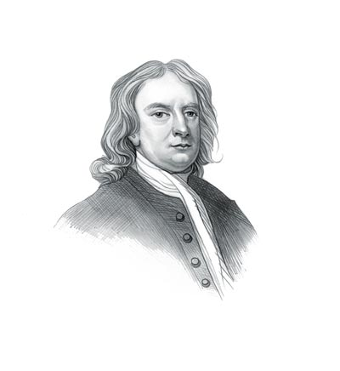
“If I have seen further, it is by standing on the shoulders of giants.”
~Sir Isaac Newton

Slide 36
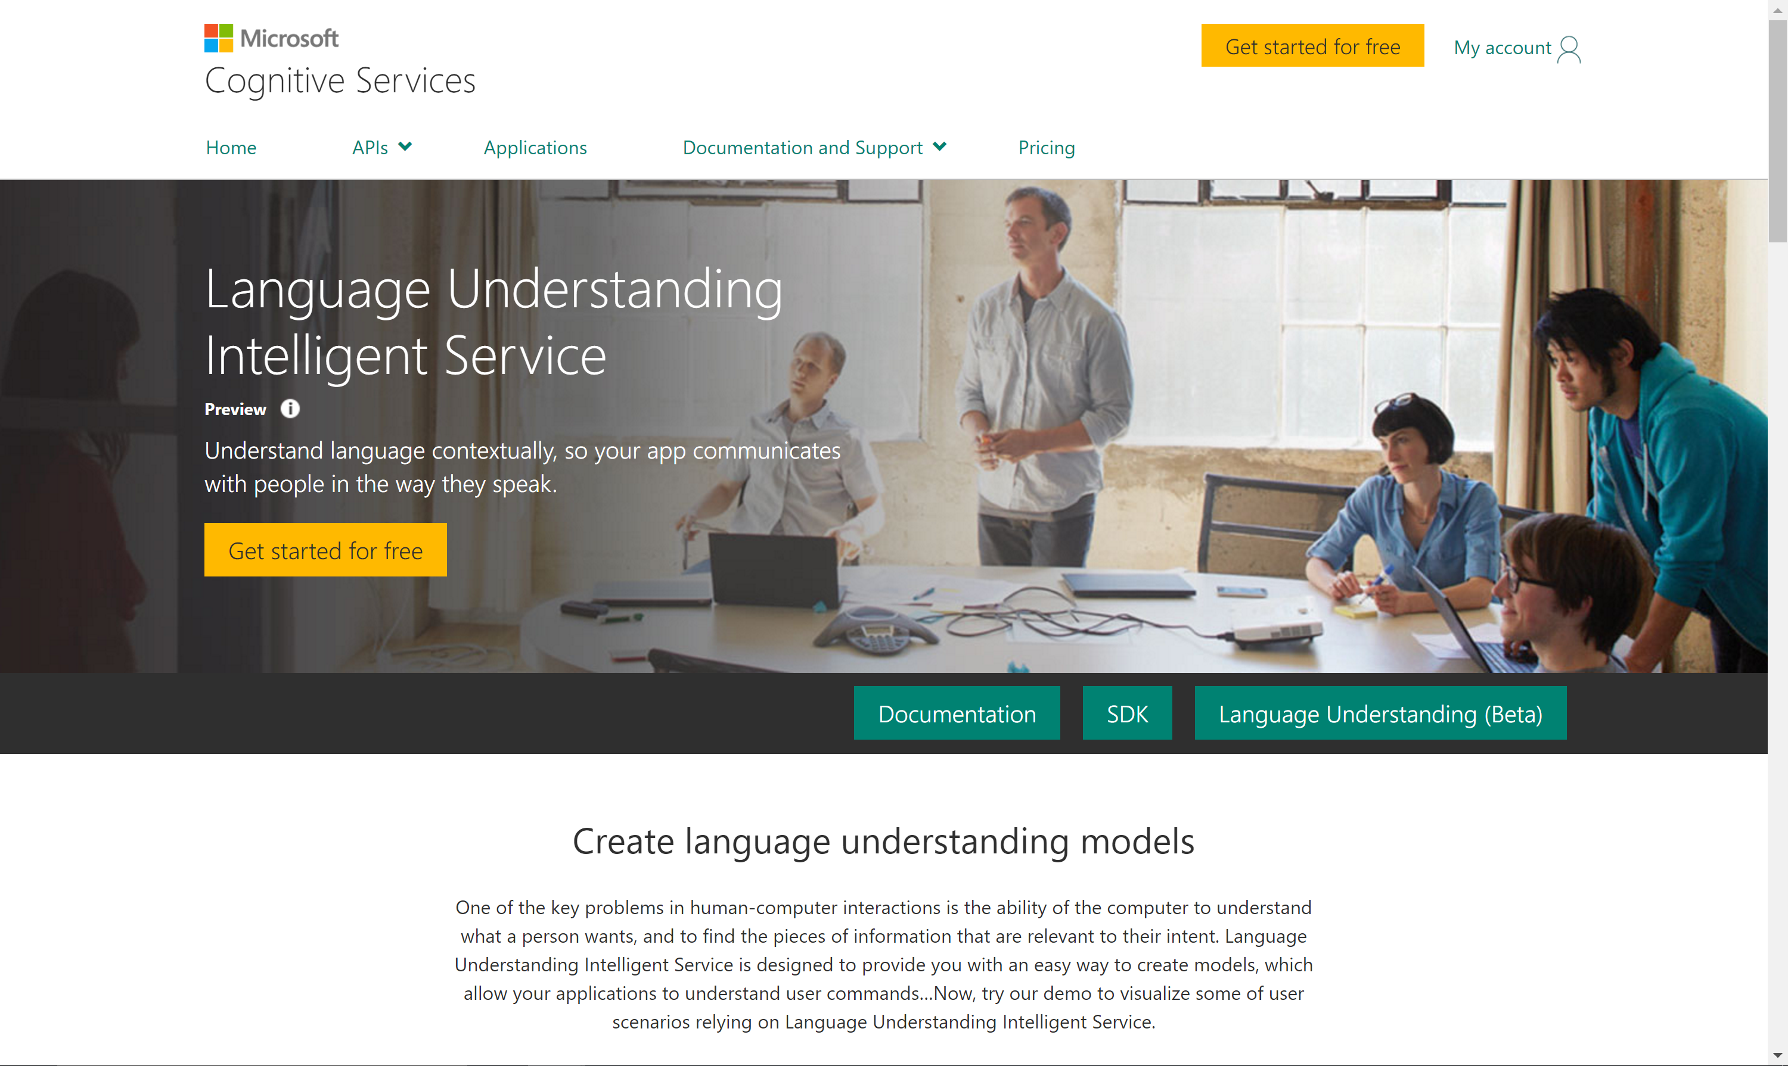

Slide 37
Determine Intent
Define Entities

Slide 38
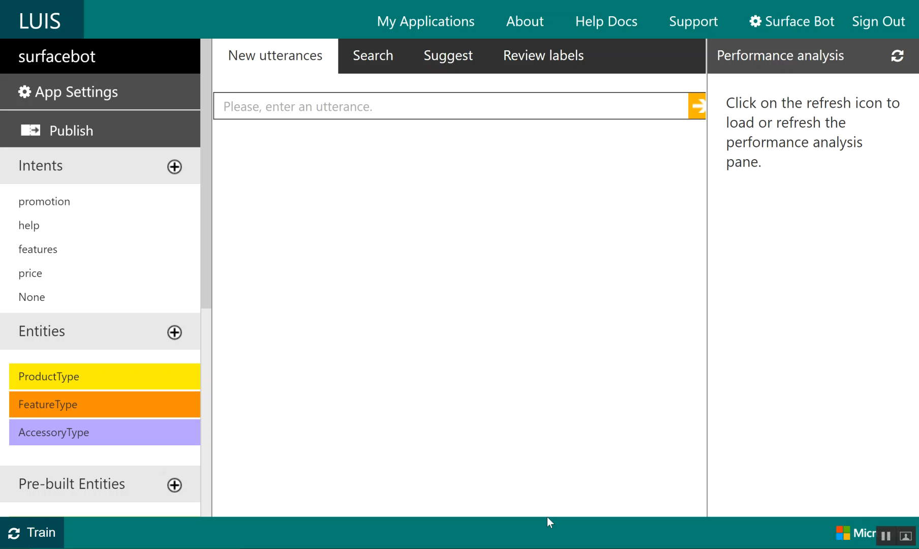

Slide 39
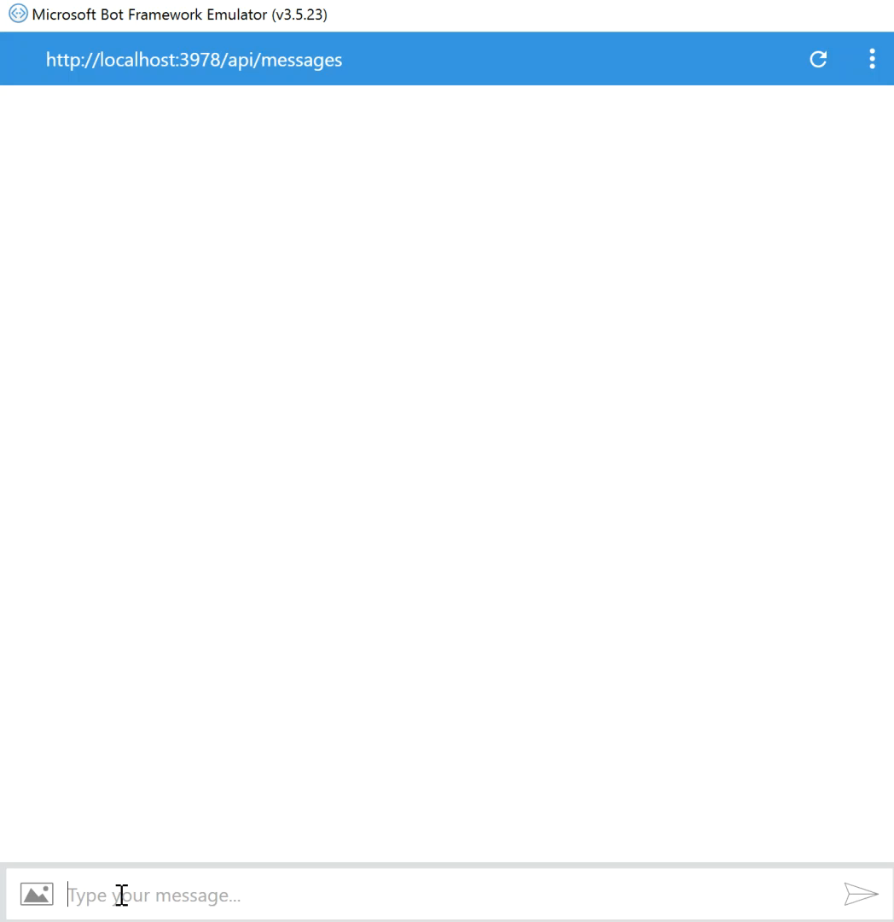

Slide 40
Intent Recognizer Interface
(*** only in node SDK)
Chat Client
Chatbot
What they said
What they meant
Intent
Recognizer
Implements IIntent Interface

Slide 41
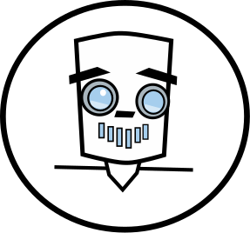
The Bot Framework

Slide 42
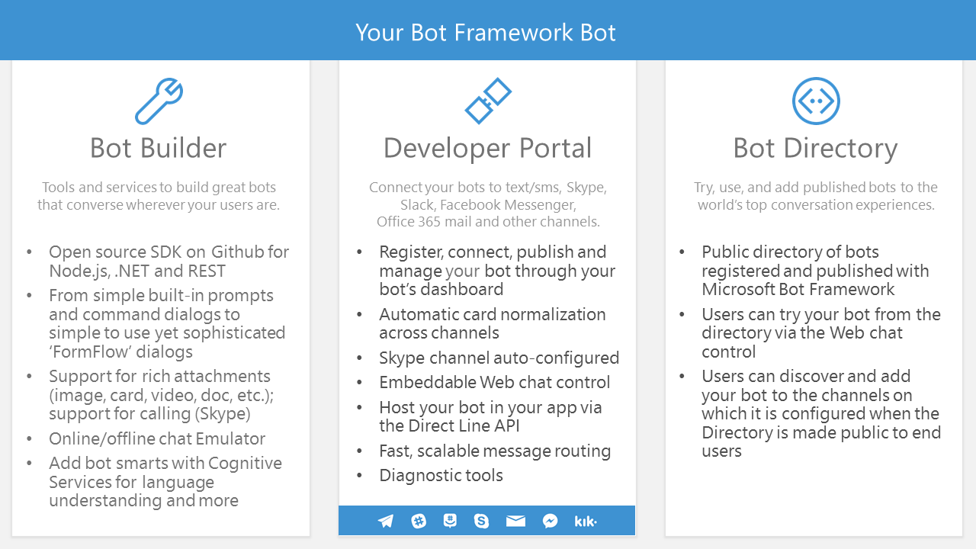

Slide 43


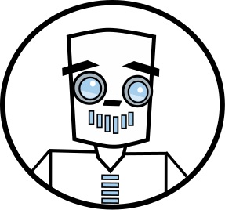





Bot Communication
User
Channel
Bot

Slide 44
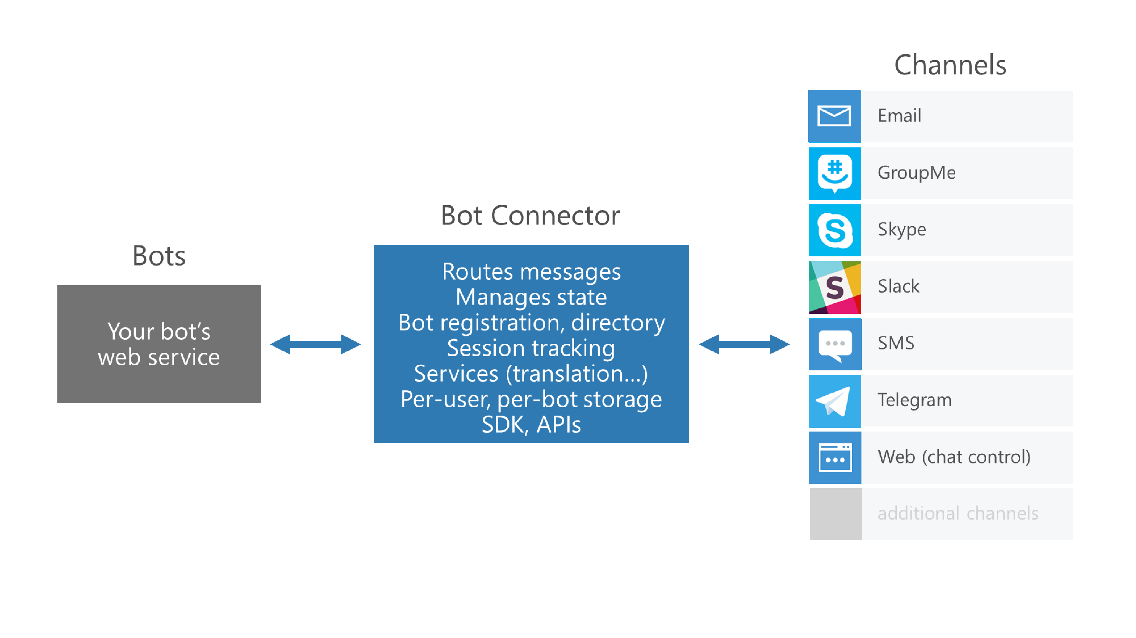
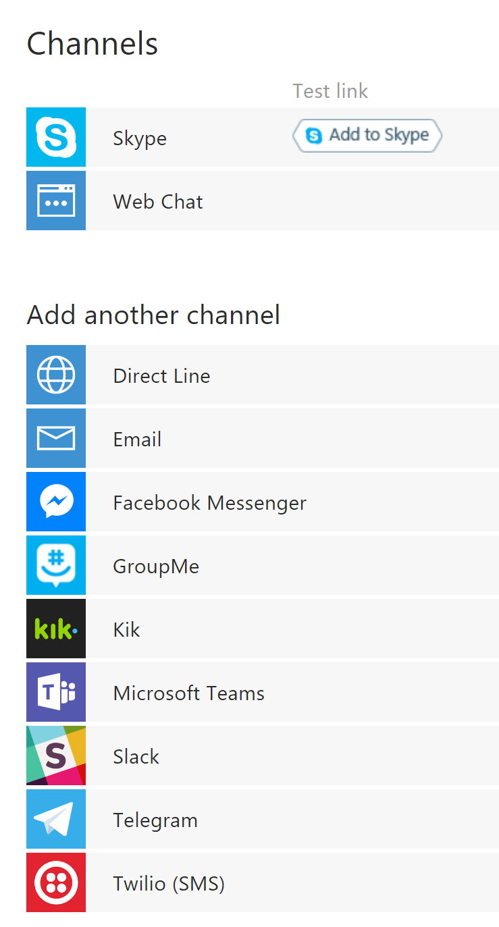
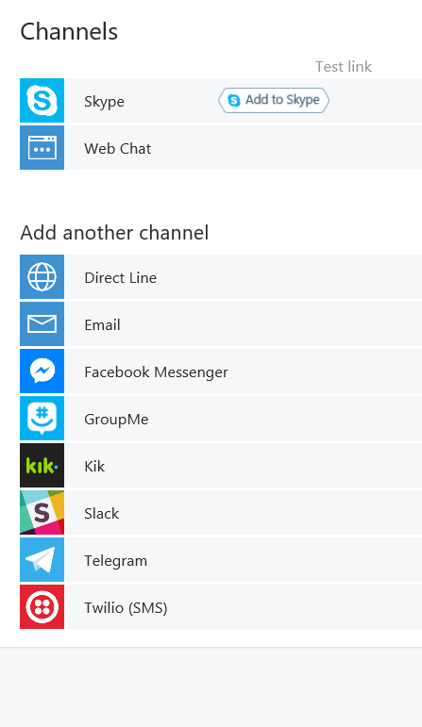

Slide 45


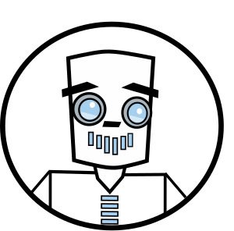
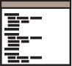
Connector Service
Connector Service
Channel
Channel JSON
Activity JSON
Bot

Slide 46
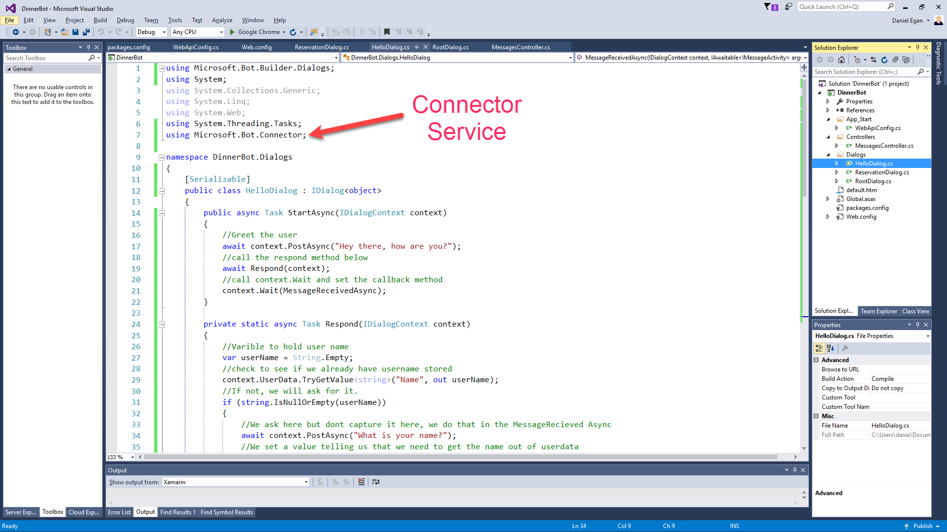

Slide 47
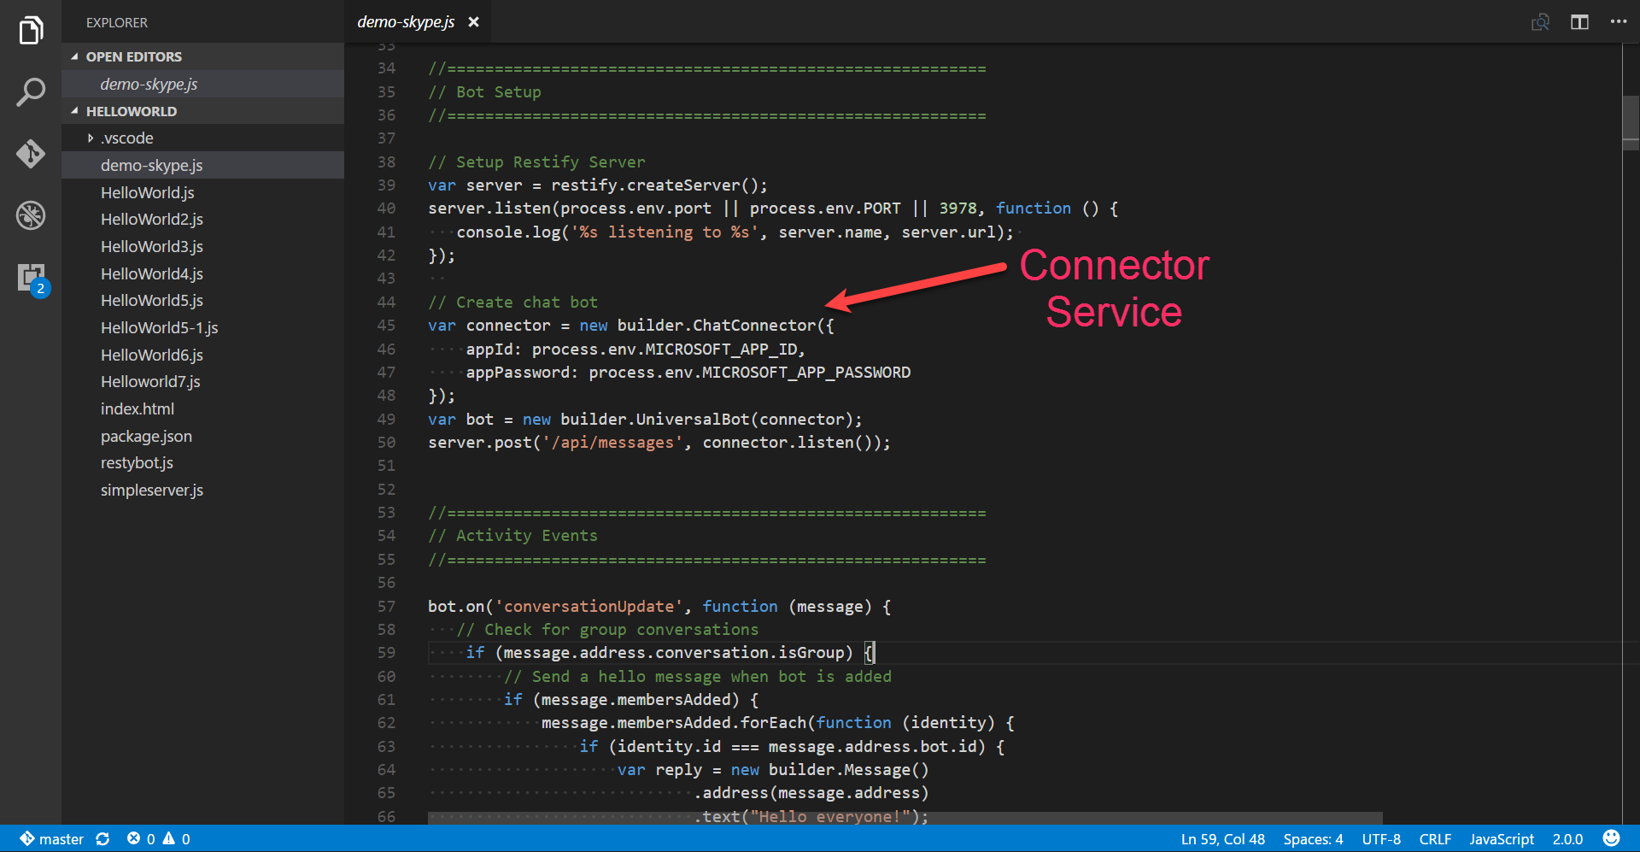

Slide 48
Connector Service
Connector Service
Channel
Channel JSON
Activity JSON
Bot

Slide 49
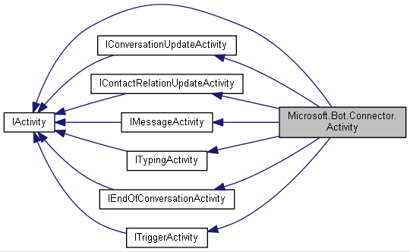
IConversationUpdateActivity
IContactRelationUpdateActivity
IActivity
IMessageActivity
Microsoft.Bot.Connector.Activity
ITypingActivity
IEndOfConversationActivity
ITriggerActivity

Slide 50
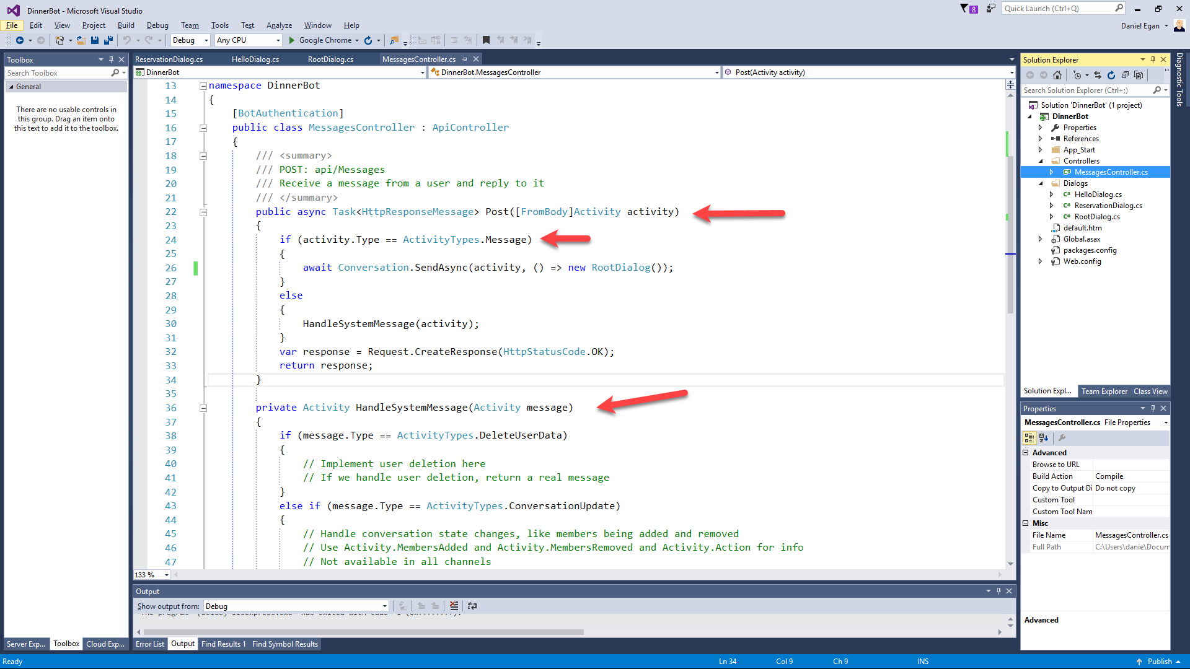

Slide 51
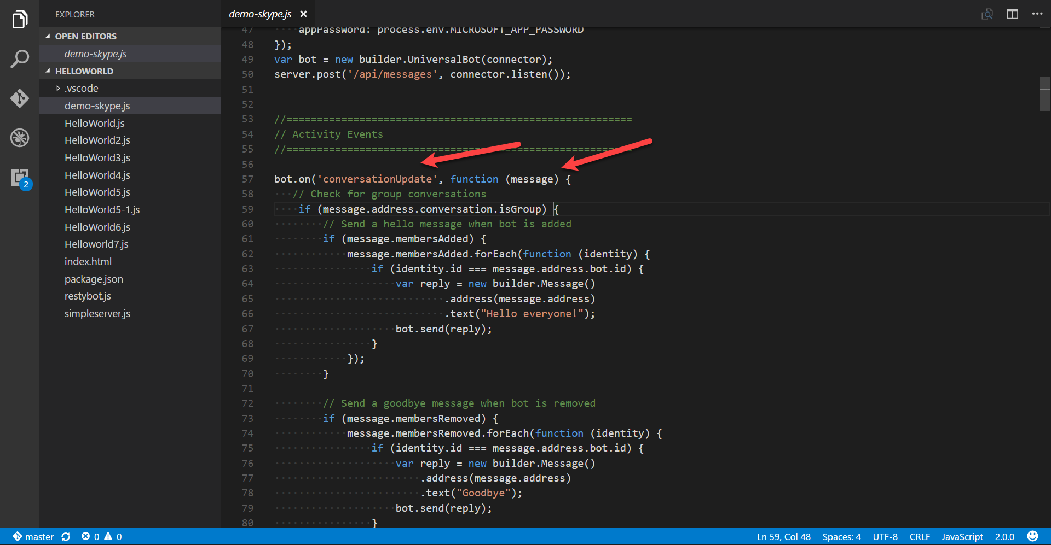

Slide 52
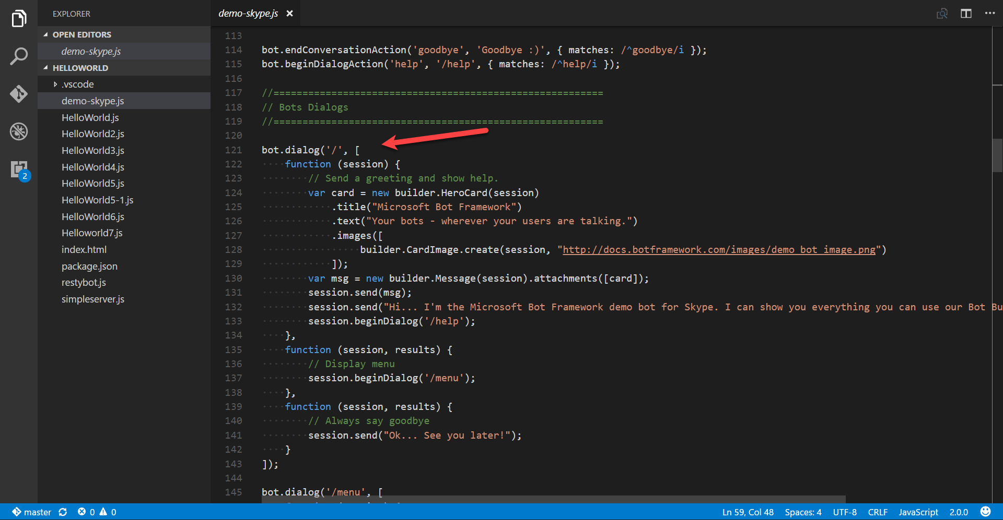

Slide 53

Dialogs
User
Bot
Hi
Hi I'm Dinner Bot how can I help you today?
I would like to reserve a table.
Great, lets get started.

Slide 54
Dialogs = Routing
Hi
How can I help you
I want to reserve a table
Do we know the user?
No
Yes
GetUserInfoDialog
ReservationDialog

Slide 55
Dialog Chain
Conversation
Introduction Dialog
User Info Dialog
Reservation Dialog
C# Chaining or Context.Call
node beginDialog/endDialog or waterfall

Slide 56
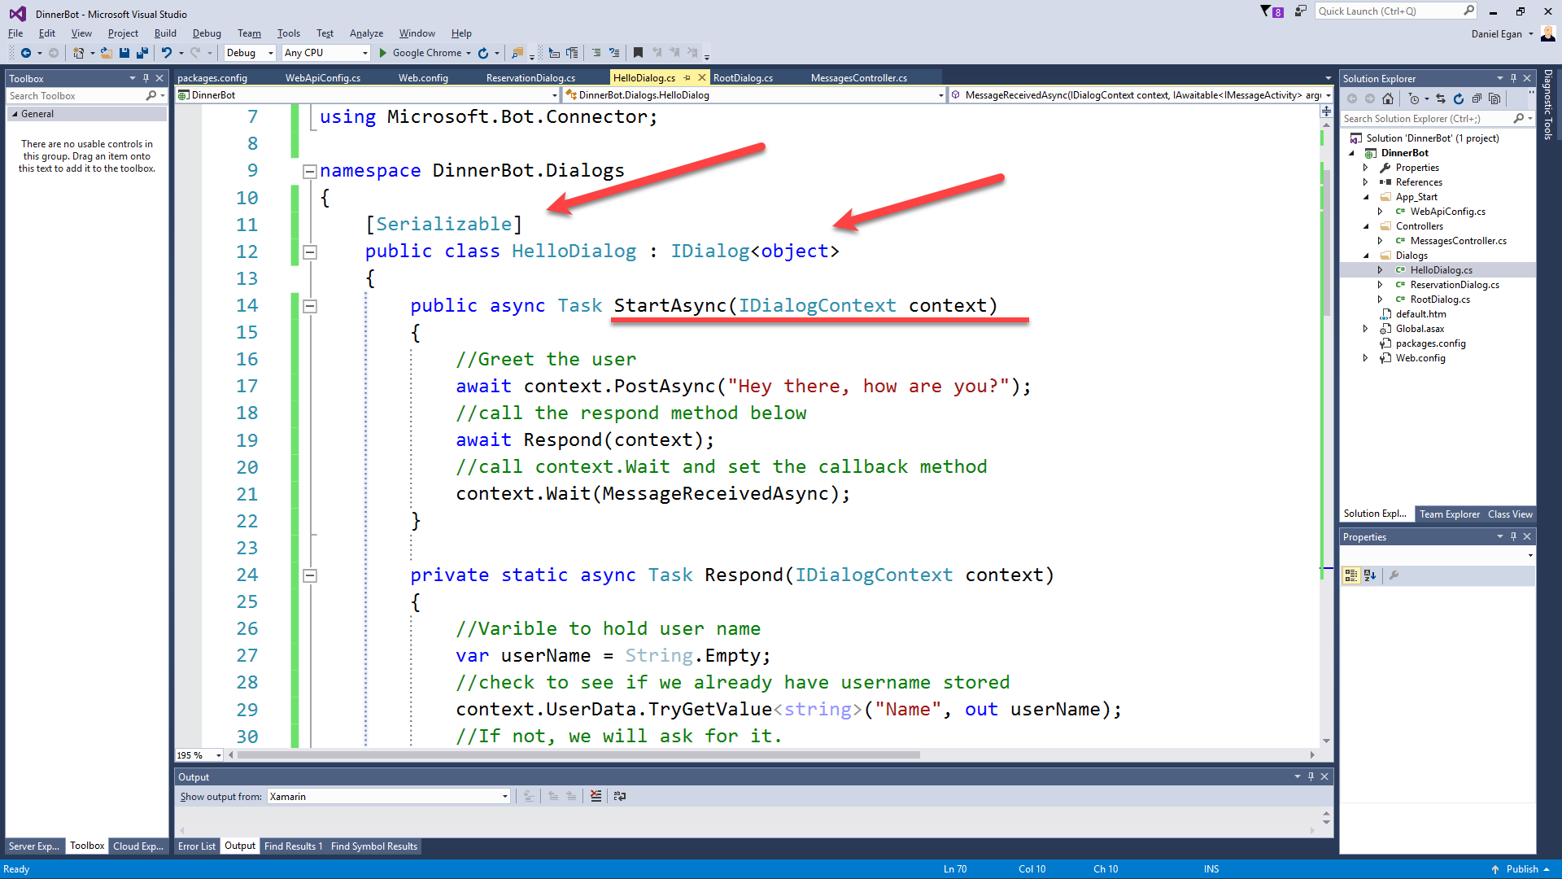

Slide 57
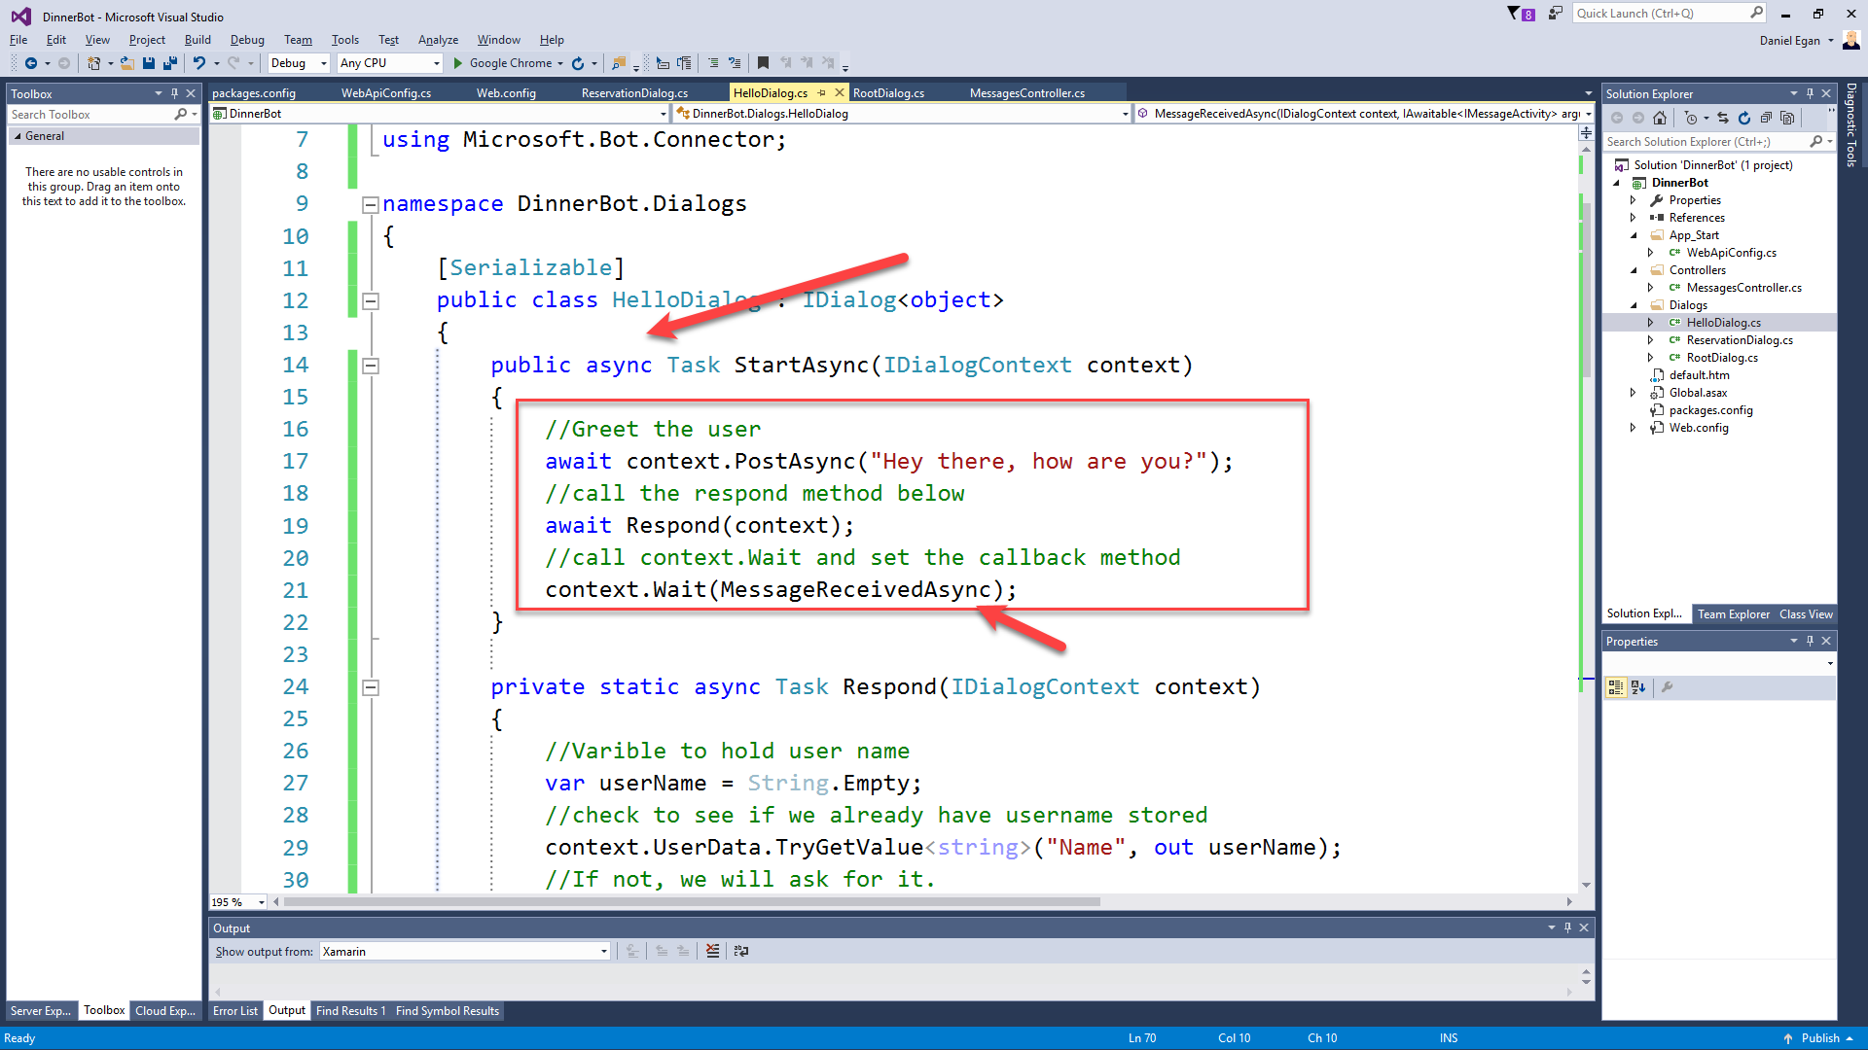

Slide 58
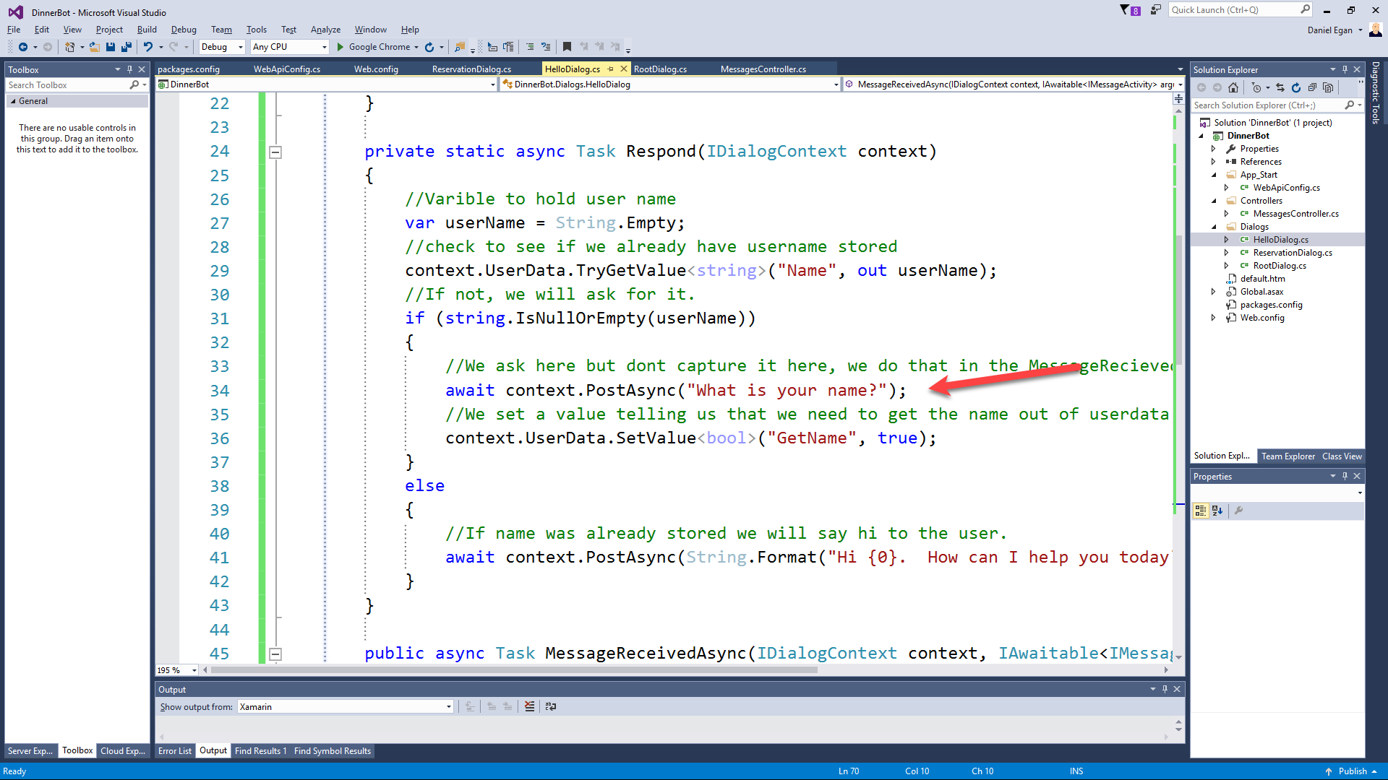

Slide 59
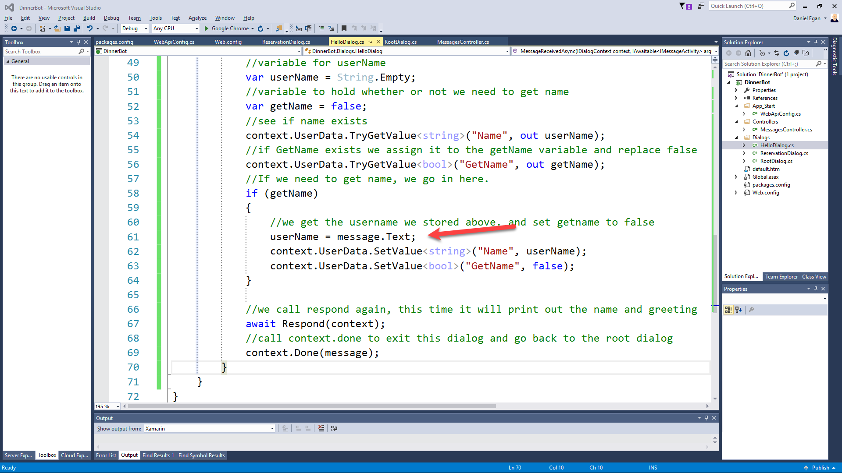

Slide 60
Helpers : Prompts and Form Flow

Slide 61
Prompt types
Prompts.text()
Prompts.confirm()
Prompts.number()
Prompts.time()
Prompts.choice()
Prompts.attachment()

Slide 62
Form Flow
(*** only in C# SDK)
What Date would you like reservations for?
User
Bot
12/14/17
For how many people?
4
What time?

Slide 63
Form Flow
(*** only in C# SDK)
What Date would you like reservations for?
User
Bot
12/14/17
For how many people?
Wait I mean 2/14/17
?????????

Slide 64
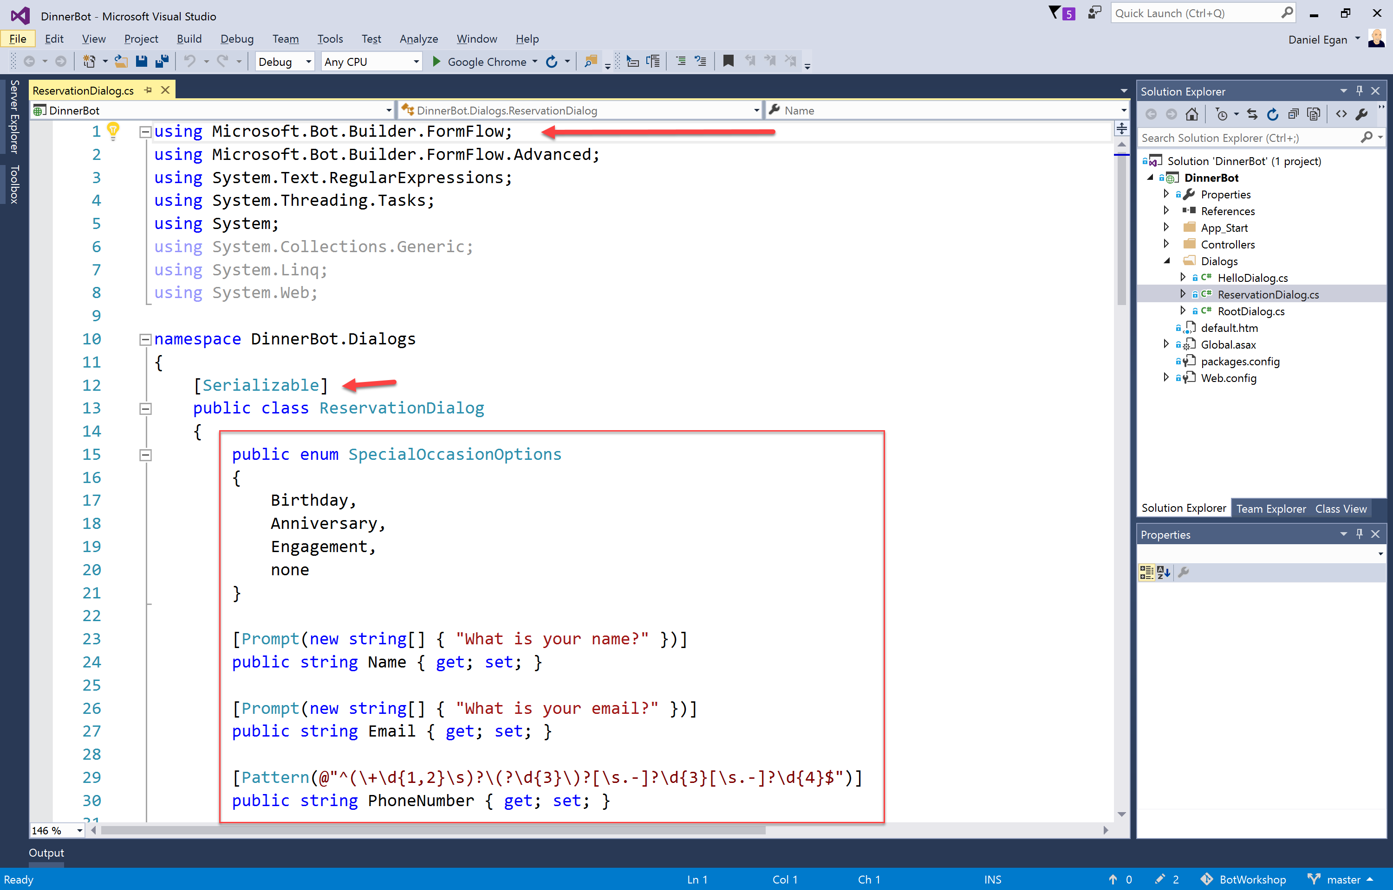

Slide 65
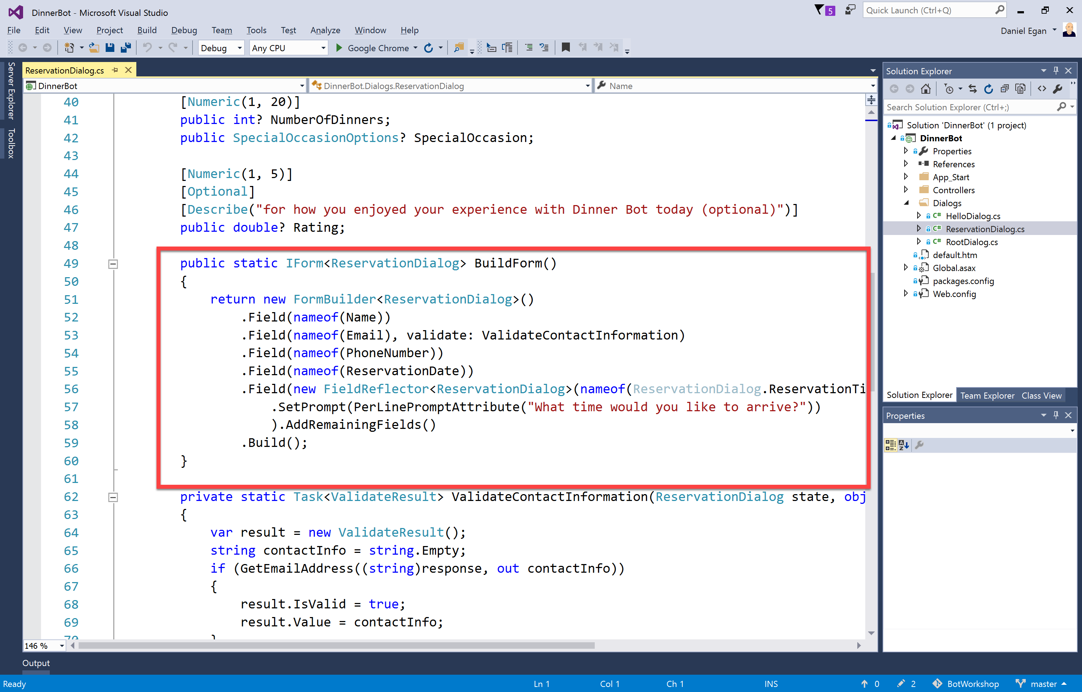

Slide 66
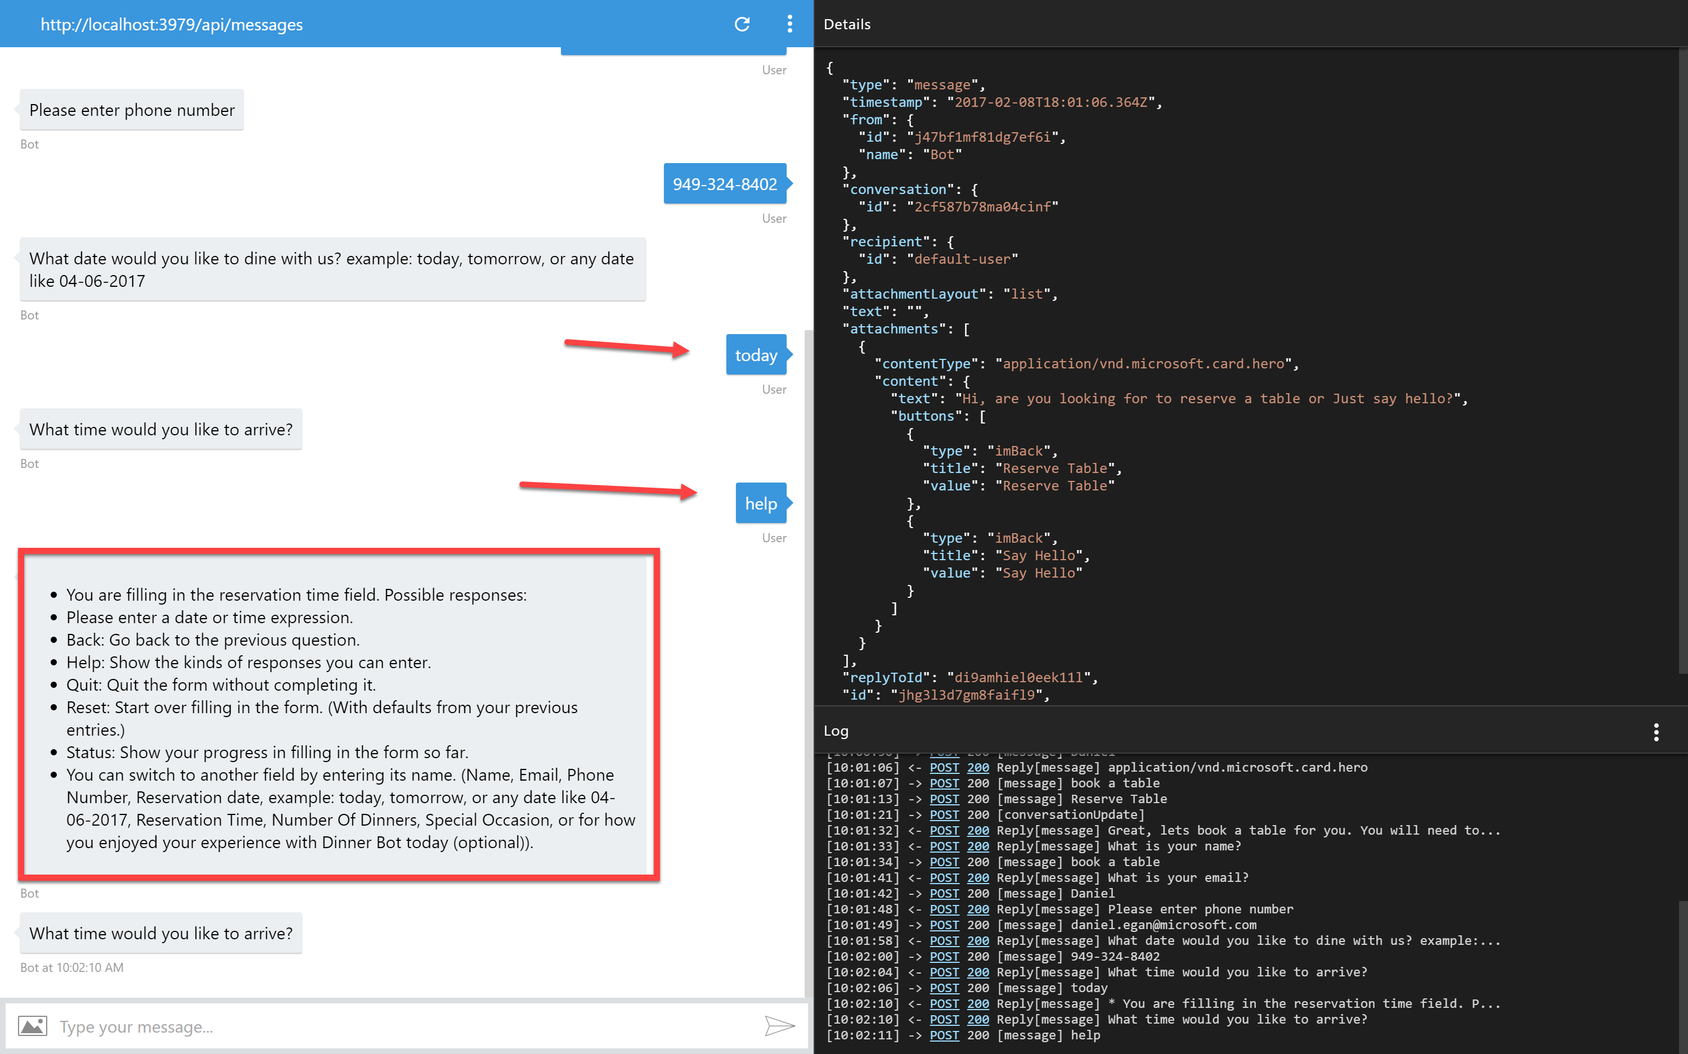
Add slide showing bot handle things.

Slide 67
What about node?

Slide 68
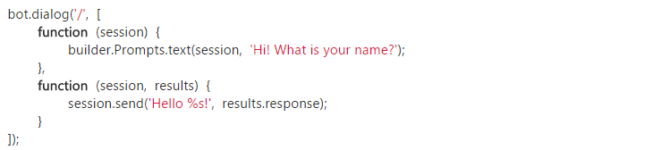
Waterfall
Exactly what it sounds like…

Slide 69
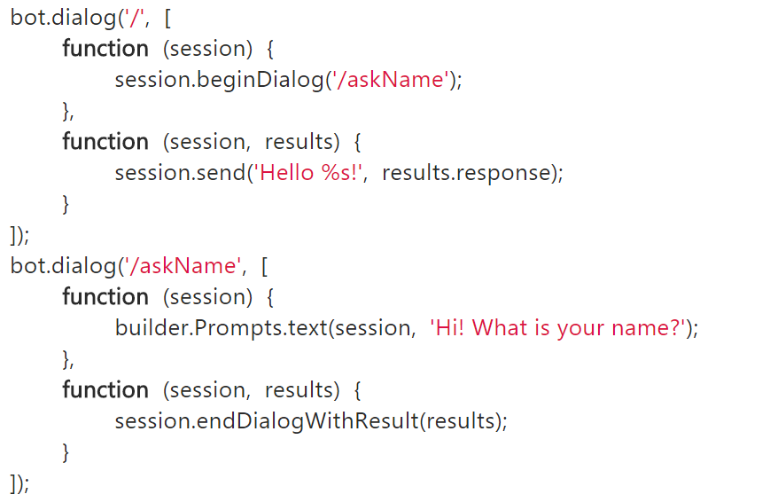
Waterfall

Slide 70
Simple Waterfall
var builder = require('botbuilder');
var connector = new builder.ConsoleConnector().listen();
var bot = new builder.UniversalBot(connector);
bot.dialog('/', [
function (session) {
builder.Prompts.text(session, 'Hi! What is your name?');
},
function (session, results) {
session.send('Hello %s!', results.response);
}
]);
Our root dialog '/'
Uses a text prompt to collect name
and put in session.
we use the result of the prompt
to echo back to user (notice that it
is an array of functions in the
dialog)

Slide 71
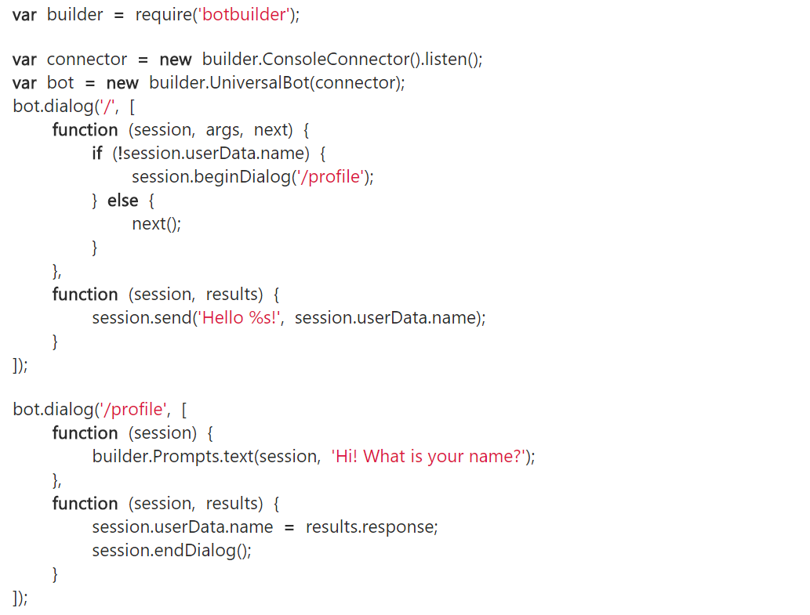
First Run
Nothing new here
Our root dialog '/'
Checks session.userdata
if no username sends to
our '/profile' dialog using
beginDialog()
We use a text prompt to collect
name
once data is collected we call
endDialog()

Slide 72
First Run
Our code flow returns here and
proceeds to the next function
We then address user by name
This whole dialog is not used
next time through

Slide 73
NEW First Run
var builder = require('botbuilder');
var connector = new builder.ConsoleConnector().listen();
var bot = new builder.UniversalBot(connector);
bot.dialog('/', function (session) {
session.send("%s, I heard: %s", session.userData.name, session.message.text);
session.send("Say something else...");
});
// Install First Run middleware and dialog
bot.use(builder.Middleware.firstRun({ version: 1.0, dialogId: '*:/firstRun' }));
bot.dialog('/firstRun', [
function (session) {
builder.Prompts.text(session, "Hello... What's your name?");
},
function (session, results) {
// We'll save the users name and send them an initial greeting. All
// future messages from the user will be routed to the root dialog.
session.userData.name = results.response;
session.endDialog("Hi %s, say something to me and I'll say it back to you.", session.userData.name);
}
]);
First Run Middleware

Slide 74
Persisting Data
userData
stores information globally for the user across all conversations.
conversationData
stores information globally for a single conversation. This data is visible to everyone within the conversation so care should be used to what’s stored there. It’s disabled by default and needs to be enabled using the bots persistConversationData setting.
privateConversationData
stores information globally for a single conversation but its private data for the current user. This data spans all dialogs so it’s useful for storing temporary state that you want cleaned up when the conversation ends.
dialogData
persists information for a single dialog instance. This is essential for storing temporary information in between the steps of a waterfall.

Slide 75
What else?

Slide 76
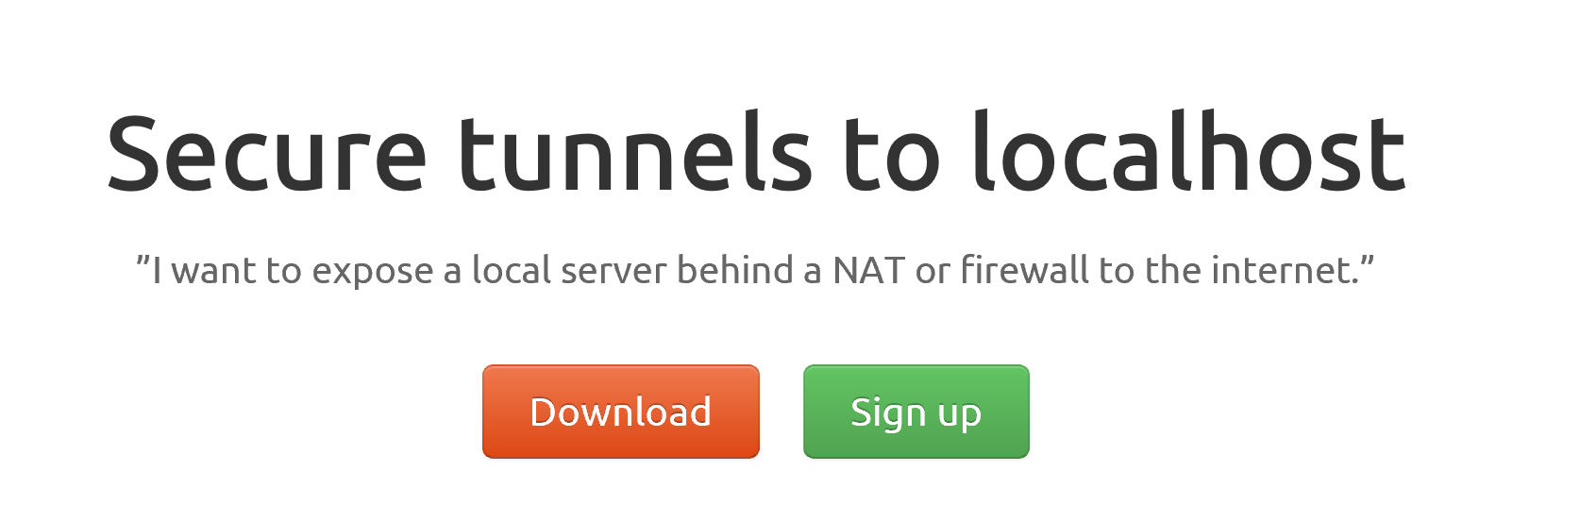
ngrok

Slide 77
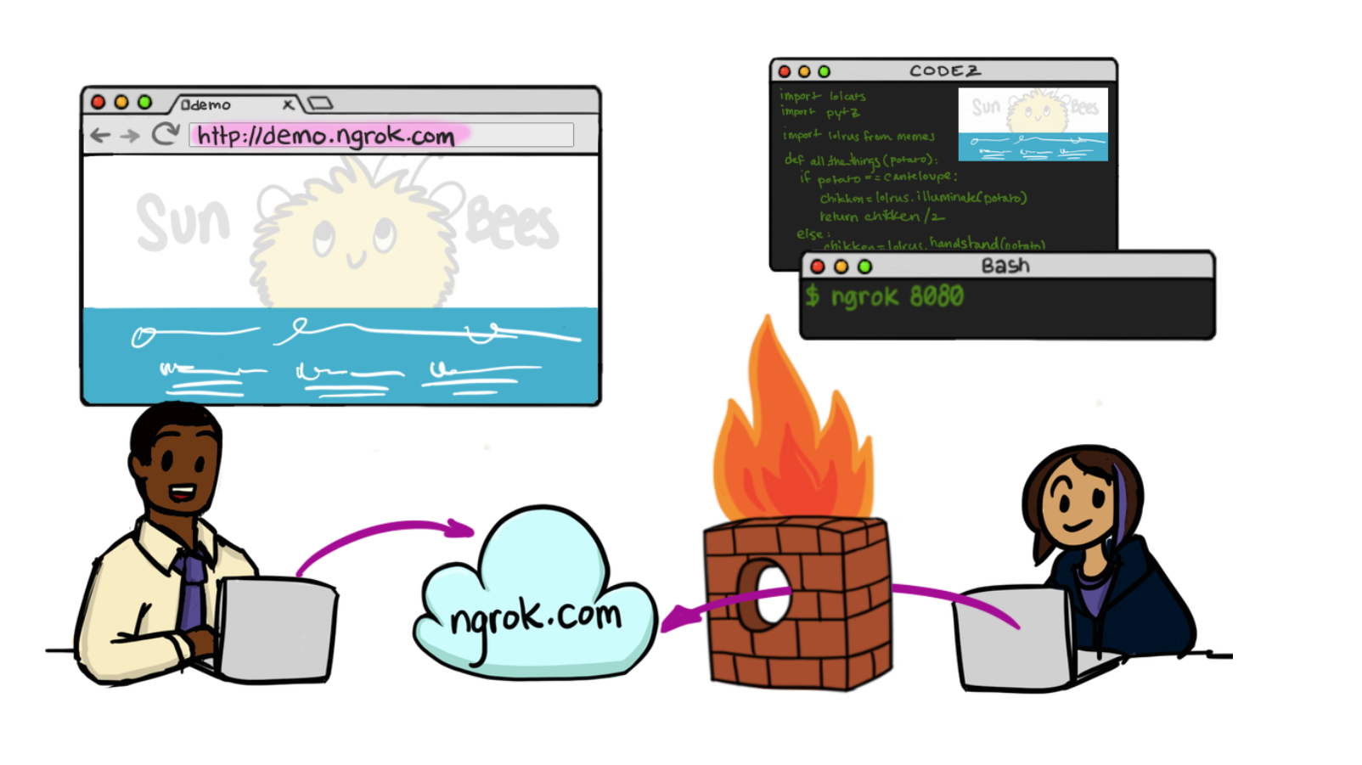

Slide 78
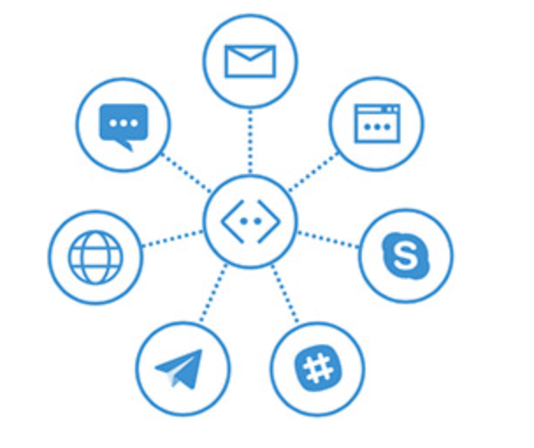

In Cloud
BotFramework

Slide 79
Let’s Get Hands on.

Slide 80
Examples of Saving time
Bot → Jenkins → Bot
Customer Service Help Desk first level support

Slide 81
Technology Needed today Node
Installs
Node.js (and npm)
Ngrok
GIT (not necessary but helpful)
VS Code (for node)
Visual Studio 2015 & Bot Template (for C#)
Signups needed
MSID
BotFramework.com
LUIS – Language Understanding Intelligent Services

Slide 82

Content
https://github.com/DanielEgan/BotWorkshop
Hands On Labs Document (WORD)
Hands On Labs Document (PDF)
Code snippets for use with PDF

Slide 83

Content
https://github.com/DanielEgan/BotWorkshop

Slide 84



Conventions Used
Don’t type the ~$
If you are using the PDF copy and paste from the txt file NOT the PDF

Slide 85
Additional Materials
https://docs.botframework.com/ - Bot Framework Docs
https://github.com/pveller/ecommerce-chatbot - Node – Implements IIntentInterface
https://github.com/Microsoft/BotBuilder - SDK’s has a samples folder
https://github.com/Microsoft/BotBuilder-Samples - Different Samples (Skype, Facebook, etc.)
https://www.luis.ai/Help - Training videos and HOL for LUIS
https://docs.botframework.com/en-us/tools/bot-framework-emulator/ Emulator download
http://aka.ms/bf-bc-vstemplate C# Bot Template
https://ngrok.com - Ngrok

Slide 86
You talking to me? Why NLP is Making Bots the New Apps.
@Daniel Egan Technical Evangelist - Microsoft

